Slide 1
Improving Our Unlisted Software Approval Project
Applied Learning Project
Kali Zahn, SUNY Empire
Notes:
Good afternoon. I’m Kali Zahn from SUNY Empire, and I’m the Assistant Director of the Technical Support Specialist (TSS), now located at our main offices in Saratoga Springs. But I spent my first 5 years in our Rochester Center.
At that time, I didn’t really have an understanding or desire to be a manager or leader. When I was in college talking to the career counseling center, I had a negative view of being a Manager because the image I had was that of a department store manager position, and I wanted nothing to do with the Retail manager positions. I didn’t really understand leadership vs management, let alone see myself in that kind of a role.
But when I moved to Saratoga, I started feeling like I had some valuable ideas, and that my experience as a remote location technician gave me a unique perspective about how support other remote techs on the TSS team. Thus, my leadership career began. I realized that I could be a supervisor and with some time I did become a supervisor and then the AD.
And now I’m ready for the next step. My goal here is to build up my skills to help me apply for the Director of the User Experience department at Empire, a position which oversees the TSS, the Service Desk and soon the Digital Media Services group at Empire.

Slide 2
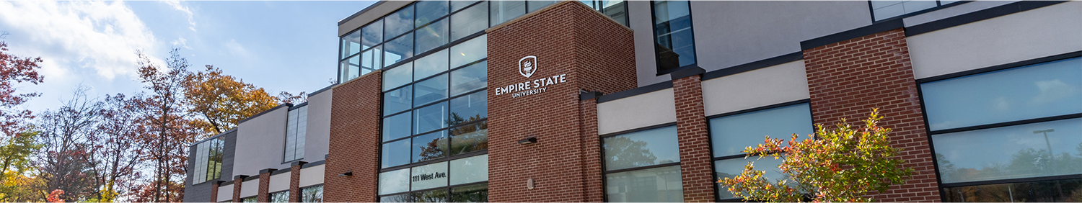
The Project
Why do we need to improve our Software process?
At Empire State, software licensing and purchasing has long been a pain point.
The goal here is to get the requests processed in a timely manner.
Notes:
Up until recently, requests for software we do not already have were going into a void, and mostly being left in a queue seemingly in the hope the need would go away.
Obviously, this is not ideal.
Over time, software purchasing has shifted from a “wild west” approach where every department just purchases what they want, and expected IT to support it- to an ITS management approach.
While the ITS managed approach makes logical sense, the reality is no one in IT has ever wanted to take over the software management process, especially going through the EULAs. I don’t know about you, but my eyes glaze over reading EULAs.
Over the last 10-15 years, we’ve had a couple of people in IT who have reluctantly taken over software management and who at least could take the time to review the licensing. But the last person left over 7 years ago.
After he left, unlisted software fell into a void. The person who had been doing it was in our Cloud Computing (or Sys Admin) group.
When he left, it stayed in that department, but no one in the department really picked up the work.
So, my goal is to revamp our process. I had to figure out what departments need to be involved and streamline the process to include all the proper groups from the beginning and get these requests processed or at least approved in a timely manner (I’m thinking that means within about 1 week.) Getting the purchase done may be a bit longer, but at least the requesters know what is happening at that point.

Slide 3

Stepping In
How this became my project
Where do you go for help with IT issues?
  The Service Desk
  The Desktop Support team (TSS team)
Notes:
Why did I decide to make this my problem to solve? 3 things led me to take on this project:
The first thing that motivated me to step in was when requesters are wondering what happened to their requests, they come to us. And us ultimately means me. They call the Service Desk, who then ask me. They ask a technician in the hallway, who then ask me. Or they contact me directly. Why? Because all those people know I can find answers and get results. After years of trying to avoid software ownership, I started advocating more for a better process...Until it became my project. We weren’t serving our customers in the best way we could, and I couldn’t let it go.
The second thing that happened while the issues were building up is that 2 years ago, I attended an STC presentation from Buff State on their Asset Management process, which included a large section on the software process. The way they included Info Sec and Purchasing made so much sense to me, and I knew that was what we needed.
And the third thing that happened is we had a major restructuring in ITS, which saw the Cloud Computing group get dissolved. Through that process, I started a new Software Managers group consisting of the AD of the Service Desk, people in 4 new positions, 2 Senior Service Desk tech and 2 senior TSS, and myself. We meet weekly to go over software tickets, but still sometimes don’t know what to do with a ticket.

Slide 4
Starting the Conversation
Starting with a small committee and then building up
  Internal IT (ITS Busiess Affairs for internal procurement, Cloud computing, Cyber Security) for the first couple meetings
  Added external offices: the university Procurement office, and Accessibility office
Notes:
I knew I needed several departments involved in this conversation. But I talked with our Director of Business Affairs in ITS, and we decided to just start internally, with ITS. My first couple of meetings were actually last summer, and then the project got moved to my back burner.
Our ultimate committee now has ITS Business Affairs, Information Security, Procurement, and Accessibility.
And fortunately, Procurement has the people who can read the Licenses, and accessibility understands the VPATS.

Slide 5


Obsticals
What are the challenges
“Not it”
Everyone thinks someone else should be first
Do we have buy-in
Do we need to be as detailed?
This Photo by Unknown Author is licensed under CC BY-SA-NC
Notes:
Overcome Obstacles: What conflicts/challenges arose? How did you resolve them?
Besides the obstacle we probably all face – trying to find time in everyone’s schedule to get a meeting on the calendar in under a month, the biggest human hurdle came early on when discussing what group should be evaluating the request at what point. Procurement, InfoSec and Accessibility all felt that the other groups should look at the request first “because the other groups might say “No” and then the other groups don’t need to look at it. While they are right that the other 2 groups could be the first to say No, there is no right order to who should go first. We’ll come back to this in a moment.
Another important piece here is you must have buy in from the CIO and really Cabinet to back up the No from any one of these groups. If anyone is staying no, there is probably a legal ramification behind it, and we do need to make sure requesters are aware of the reason behind the denial, but we do need that authority to say no.
And finally, (but least problematic) as I built out the flowchart, I started with something similar to the Buff State model, but when I brought it to my Software Management group to the flow with them, we decided there were too many levels, and we didn’t need that much detail for our workflow.

Slide 6
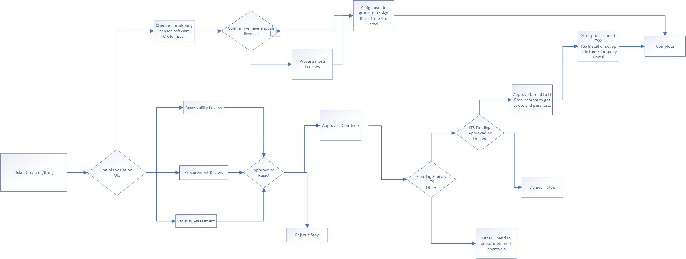
Workflow Solution
Notes:
So, here’s our workflow:
The solution for our “Who’s on First” debate about which group should get the request first that I mentioned in the last slide. There is no need for one group to go first. As you can see here, we created the workflow to have the request to go to all groups at once. I have presented the larger group with this solution, and they seem to agree (although we’ll see if the plan survives contact with our users.)
If any one group says no, the tasks that went to the to the other groups will close.

Slide 7
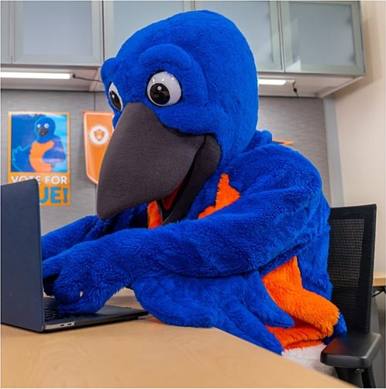
Conclusion
Work in progress
Realistic live date – August 2026
My next step after launching this is to see about merging our Hardware request and software request into on request with a better breakout.
Notes:
I haven’t finished the project yet, but I think we can realistically have this all in place by August of this year.

Slide 8

Questions?
This Photo by Unknown Author is licensed under CC BY-SA-NC

