Slide 1


CIO Leadership Academy Applied Learning Project

Slide 2
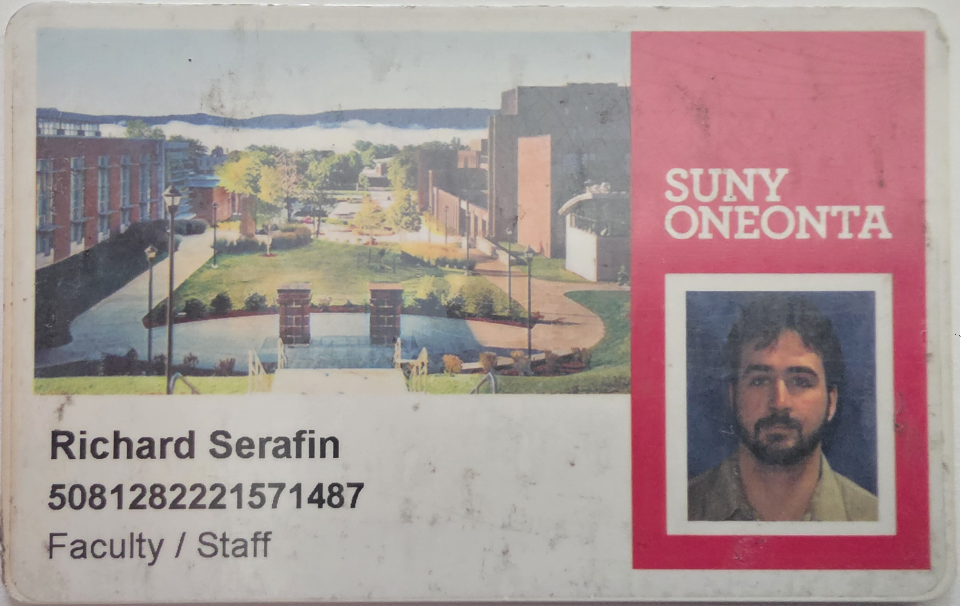
Notes:
Hello I’m Rick Serafin and I work at SUNY Oneonta in the ITS department where I have worked since my graduation there in 1997. I am an Alum of Oneonta and that ID card with my mug shot from almost 30 years ago is still in my wallet today.

Slide 3
Re-Carding Campus
Richard Serafin
SUNY Oneonta
Notes:
Card Access has been on campus almost as long as I have beginning in 1999 and my project is titled Re-Carding Campus.

Slide 4
The Setup
        Oneonta implemented card access over 27 years ago
        Over 850 doors have card access
        Over 10,000 ID Cards in the system
Notes:
Over those 27 years almost every exterior door, residence hall, computer lab, laundry room, science lab, meeting room, telecomm closet have all had card access added…. over 850 doors.
And with that we have over 10,000 cardholder records in the system including students, employees, contractors, guests, temporary IDs, even some retirees, you name it.

Slide 5
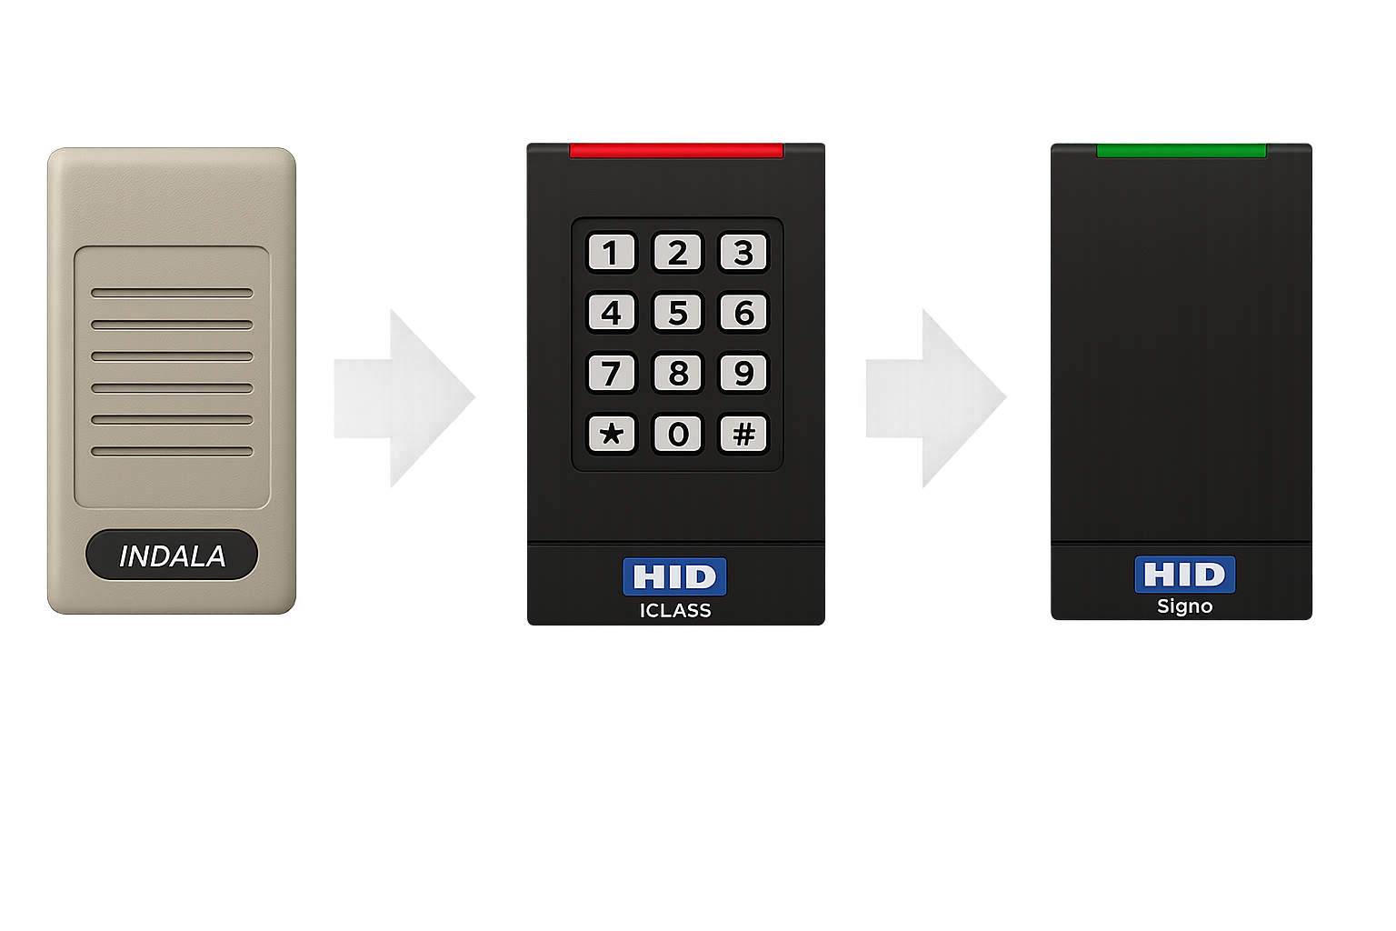
The door hardware tech has been replaced over the years
Low Frequency LF+HF LF+HF+NFC+BT
1999
2010
2020
Notes:
We have upgraded our card readers
We started with the INDALA low frequency readers
Which started getting replaced with ICLASS readers around 2010
Which then started getting phased out with Signo readers about 6 years ago
We still have 2 of those Indala readers in service that only have low frequency prox capability
And we still have 280 of the iClass readers with additional high frequency capability
But the majority have been replaced with Singo readers that do High and Low frequency plus NFC (near field communication) and Blue Tooth

Slide 6
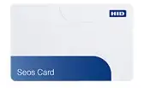
The ID Card tech on campus has not changed.
The current ID Card is a low frequency unencrypted prox card.
1999
2026
Notes:
The ID Cards although you can go get replacement card if you lose yours or it stops working… have not changed.
They are the same low frequency proximity card from years ago.

Slide 7
  The Project
  Goal:
  Replace all Prox ID Cards (Low Frequency - 125 kHz) on campus
  with Seos Cards (High Frequency – 13.56MHz)
  Why:
    Security – AES–128 bit encryption prevents cloning and unauthorized access
    High Frequency – 13.56MHz has a longer read range
    Migration Path – to Mobile devices with NFC if desired in the future
*Not planning to go Mobile in the next 3-5 years
Notes:
So, the goal of the project is to replace all of those low frequency prox cards on campus
with cards using Seos technology from HID that has 128 bit encryption, a higher frequency with longer read range and put the campus in a better situation to potentially migrate to NFC or BlueTooth for mobile credentials in the future
if they desire.
But, as of right now the decision has been made that we won’t be going mobile for at least 3-5 years if at all.

Slide 8
Evidence of a High Performing Team
Information – make sure everyone has all the information
Communication - weekly meetings with open discussion
^{The Team}
              ITS CIO office Now responsible for Card Access
                ^{ITS Security Office}
                ^{ITS Systems Office}
                ^{ITS Networking & Telecomm}
                ^{ITS Desktop support & Labs}
              ^{OAS Business Office}
                ^{OAS ID Card Office}
Notes:
So, we put together a team and held our first meetings in February to start discussing what re-carding the campus would look like… we needed to gather information, share it, and make a plan.
A key thing to note here is that up until last year card access was under the management of Facilities and the guy who did it decided to retire. With that Card Access got handed of to ITS.

Slide 9
Evidence of a High Performing Team
Break-out Teams – to get tasks done
Communication – Phone calls, E-Mails, Chats
^{Discovery teams}
^{ID Card Use Cases on Campus}
^{Card Technology options}
Notes:
So, from those meetings we broke out into teams to do Discovery
Door access isn’t the only way ID Cards are used on campus, so we needed to know what offices and services would potentially be impacted
What hardware technology is being utilized like Prox card readers and mag stripe readers?
What data is being read from the card… CardProx Number, student or employee A# from Banner, and there is an ISO Number on the card
And what are our options were in new card technologies
As I mentioned the guy who knew the answers to all these questions worked in Facilities and retired last year… he was a one man show. We had literally zero experience with the software and hardware before last year and so now we had a lot of homework to do.

Slide 10
Evidence of a High Performing Team
Break-out Teams – to get tasks done
Communication – Phone calls, E-Mails, Chats
^{Testing teams}
          ^{Testing}
          Sample Cards – Prox+SE, SE, Prox+Seos, Seos
          ^{Re-Configuring Devices}
          ^{ID Card office workstation}
          ^{Printers with card readers}
          Verification Readers – Fitness Centers, Student Union
          ^{Replace Readers}
          Replace 30 readers that just didn’t work with Seos
Notes:
We narrowed the selection of card types down to SE, Seos, and SE or Seos with Prox available
And then we had teams go out and test the cards. Sample cards went out to OAS, Desktop support , Networking, and the Systems team
We found that Certain readers and swipes needed to be replaced and certain ones could just be reconfigured.
So, There will be work to do over the summer to prepare

Slide 11
Discovery Results
Card Tech
Seos alone offers the encryption and the inability to clone
Services Impacted
            ITS Systems running the Card Access software
            ITS Networking & Telecomm supporting Card Access hardware
            ^{OAS Dining Services}
            ^{OAS Vending Services}
            ^{OAS ID Card Office}
            ^{Student Printing}
            ^{Library Services}
            ^{850 card access doors}
            Verification readers in multiple areas
Notes:
In the end the card with a single technology, Seos, was chosen. It offered 128 bit encryption, the longer read range high frequency, and the inability to clone unlike the prox card.

Slide 12
Testing Results
Services Impacted
            Card Access software – Good to go
            Card Access hardware – 30 readers need replacement
            OAS Dining Services – Good to go
            OAS Vending Services – Good to go
            OAS ID Card Office – Card reader/swipe replaced and programmed
            Student Printing – Either reconfigure or replace readers this summer
            ^{Library Services – Good to go}
            Verification readers – Mixed bag
Notes:
Most services were good to go
there are 30 card access door readers that will need be replaced
There are about 100 printers that will need their readers either replaced or re-configured
The ID Card office as a part of testing got an upgraded reader/swipe for provisioning cards to cardholders in the Millennium Ultra Card Access system
There are a handful of swipes and verification readers that are either good, need to be configured, or replaced and that will get done this summer.

Slide 13
Overcome Obstacles
What conflicts/challenges arose?
Cost – over $150,000?
Tech Compatibility – dining, vending, doors, readers, printers, library, other?
Time – to physically replace readers
to reconfigure printers
to distribute 10,000 new cards
Notes:
The initial assumption was that these cards would be two to three times the cost of our existing cards and the 280 iClass readers would need to be replaced with signo readers
There was significant operational uncertainty regarding the technology we had in the field currently using the prox ID Cards and we didn’t know what would work with a newer Seos standard
And Time is always a concern, we need to replace these cards ASAP

Slide 14
Overcome Obstacles
How did we resolve?
Cost: $5 per card - $50,000
$250 per reader - $7,500
card printer ink - $3,000
Compatibility: Seos works almost everywhere with some devices needing a little tweaking
Time: Net & Tel to replace 30 readers
Desktop support to reconfigure 100 printers
phased roll out of cards:
- replace all employee cards by the end of the year
- student cards through a natural life cycle of 4 to 5 years
Notes:
Our high performance teams worked with the vendors and got pricing to match our existing card cost. This means over a roughly 5-year period there shouldn’t be any significant cost increase in the service.
Manual testing of printers, dining hall and library card swipes, visiting all 280 iClass readers still in service and testing them with the Seos card proved it was good almost everywhere,
The time factors are 30 card access readers that need to be replaced, 100 printer readers that need to be reconfigured, and a phased rollout to get new cards in production ASAP

Slide 15


Final Thoughts and Reflections
^{Don’t work in silos}
^{Communicate}
^{Offer solutions}
Notes:
Final Thoughts and Reflections
Don’t work in Silos like the retired Facilities card access coordinator did
Communication is key
And offer solutions not problems like a phased roll out or send the new guy out to card swipe 280 doors for testing

