Slide 1


Improving Efficiency in a Custom Report Generation System

Slide 2
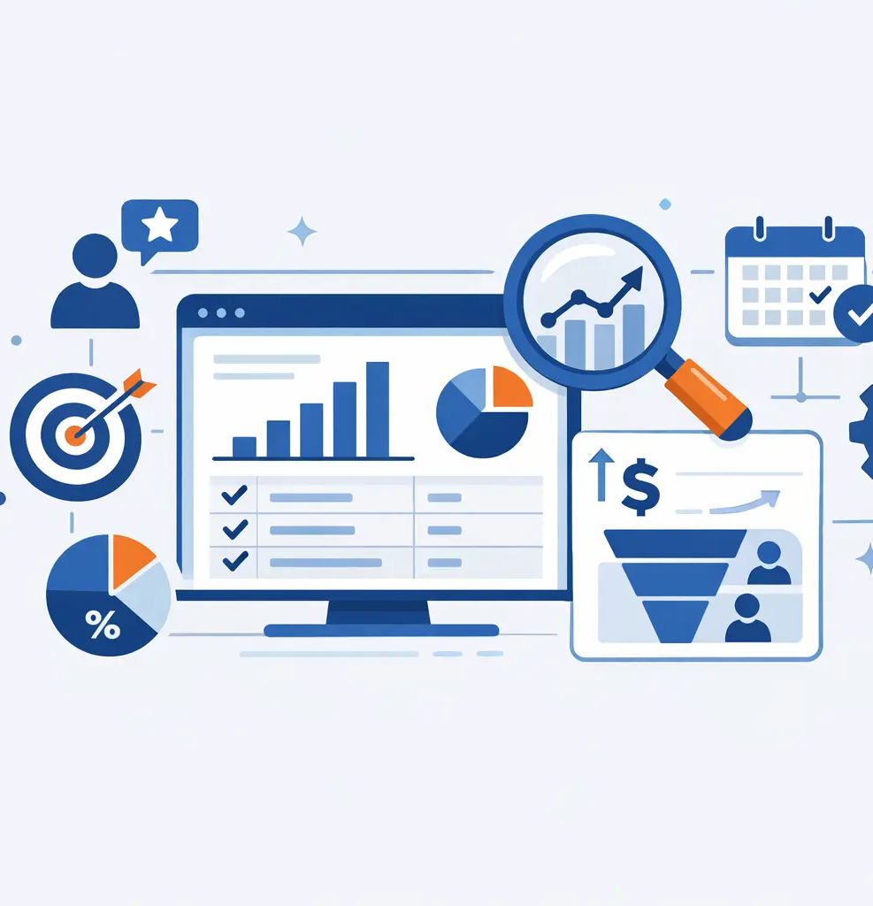
Background
Analyzing the existing Enterprise Resource Planning (ERP) reporting workflow to identify inefficiencies and limitations
Implementing standardized process improvements to ensure reliable and consistent reporting

Slide 3

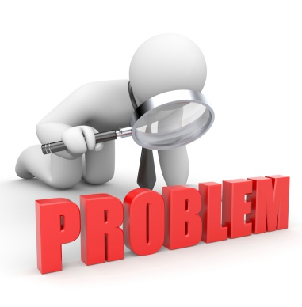
Key Problems Identified
Inconsistent report build practices
Poor discoverability and usability
Difficult user experience

Slide 4

Goals
Reduced custom report development time
Improved data consistency across ERP reporting
Establish and maintain reporting standards within ongoing ERP governance

Slide 5

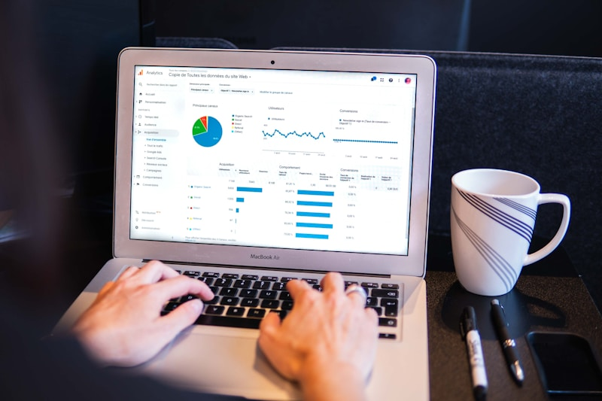
The Reporting Standards Team
. Team of 4 ERP staff members:
. Director of ERP Systems and Information Security
. ITS Coordinator and Project Lead
. Two ITS Assistant Coordinators
* Bi-weekly, agenda-driven meetings focused on decisions and challenges
* Open communication and shared ownership of outcomes
* Clear expectation of why standardization mattered to reduce resistance

Slide 6
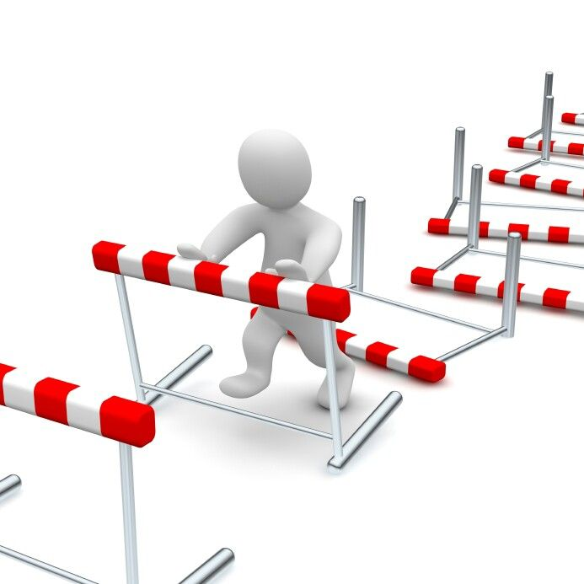
Challenges and Resolution
Resistance to Standardization:
Addressed by highlighting long-term efficiency, consistency, and improved decision-making
Poor Report Accessibility:
Resolved by implementing standardized naming convention, descriptions to improve discoverability and reliability

Slide 7
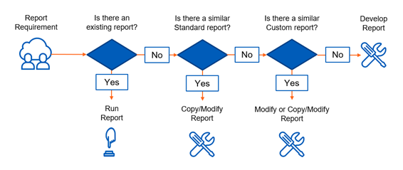
Custom Report Workflow

Slide 8
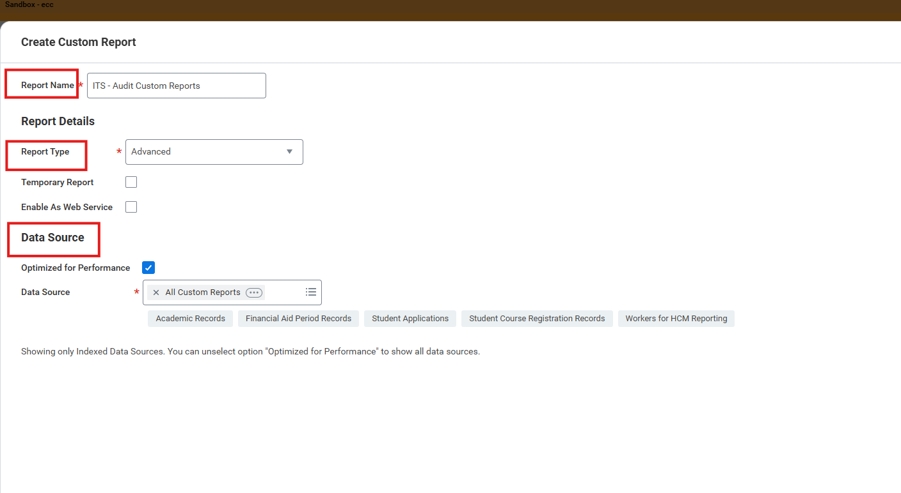
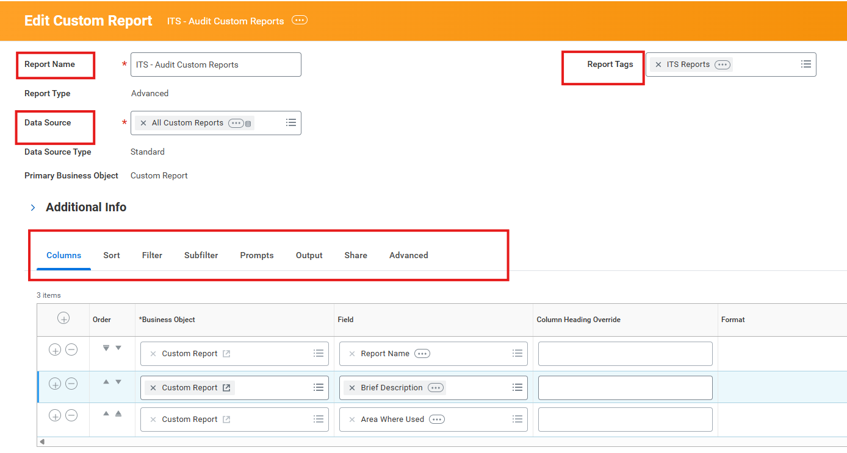
Develop Custom Report

Slide 9

Final Thoughts and Reflections
Project is 65% complete – Scheduled to finish July 1, 2026
Testing reinforced – Updated report changes
Ongoing Commitment – Continued collaboration and communication among the Reporting Standards Team and functional users

Slide 10

Questions?

