Slide 1

Advancing Strategic IT in Our College Through Project Portfolio Management
A CIO Academy Journey in Leading Change
SUNY SAIL INSTITUTE | CIO ACADEMY
Eric Grove
SUNY Orange

Slide 2
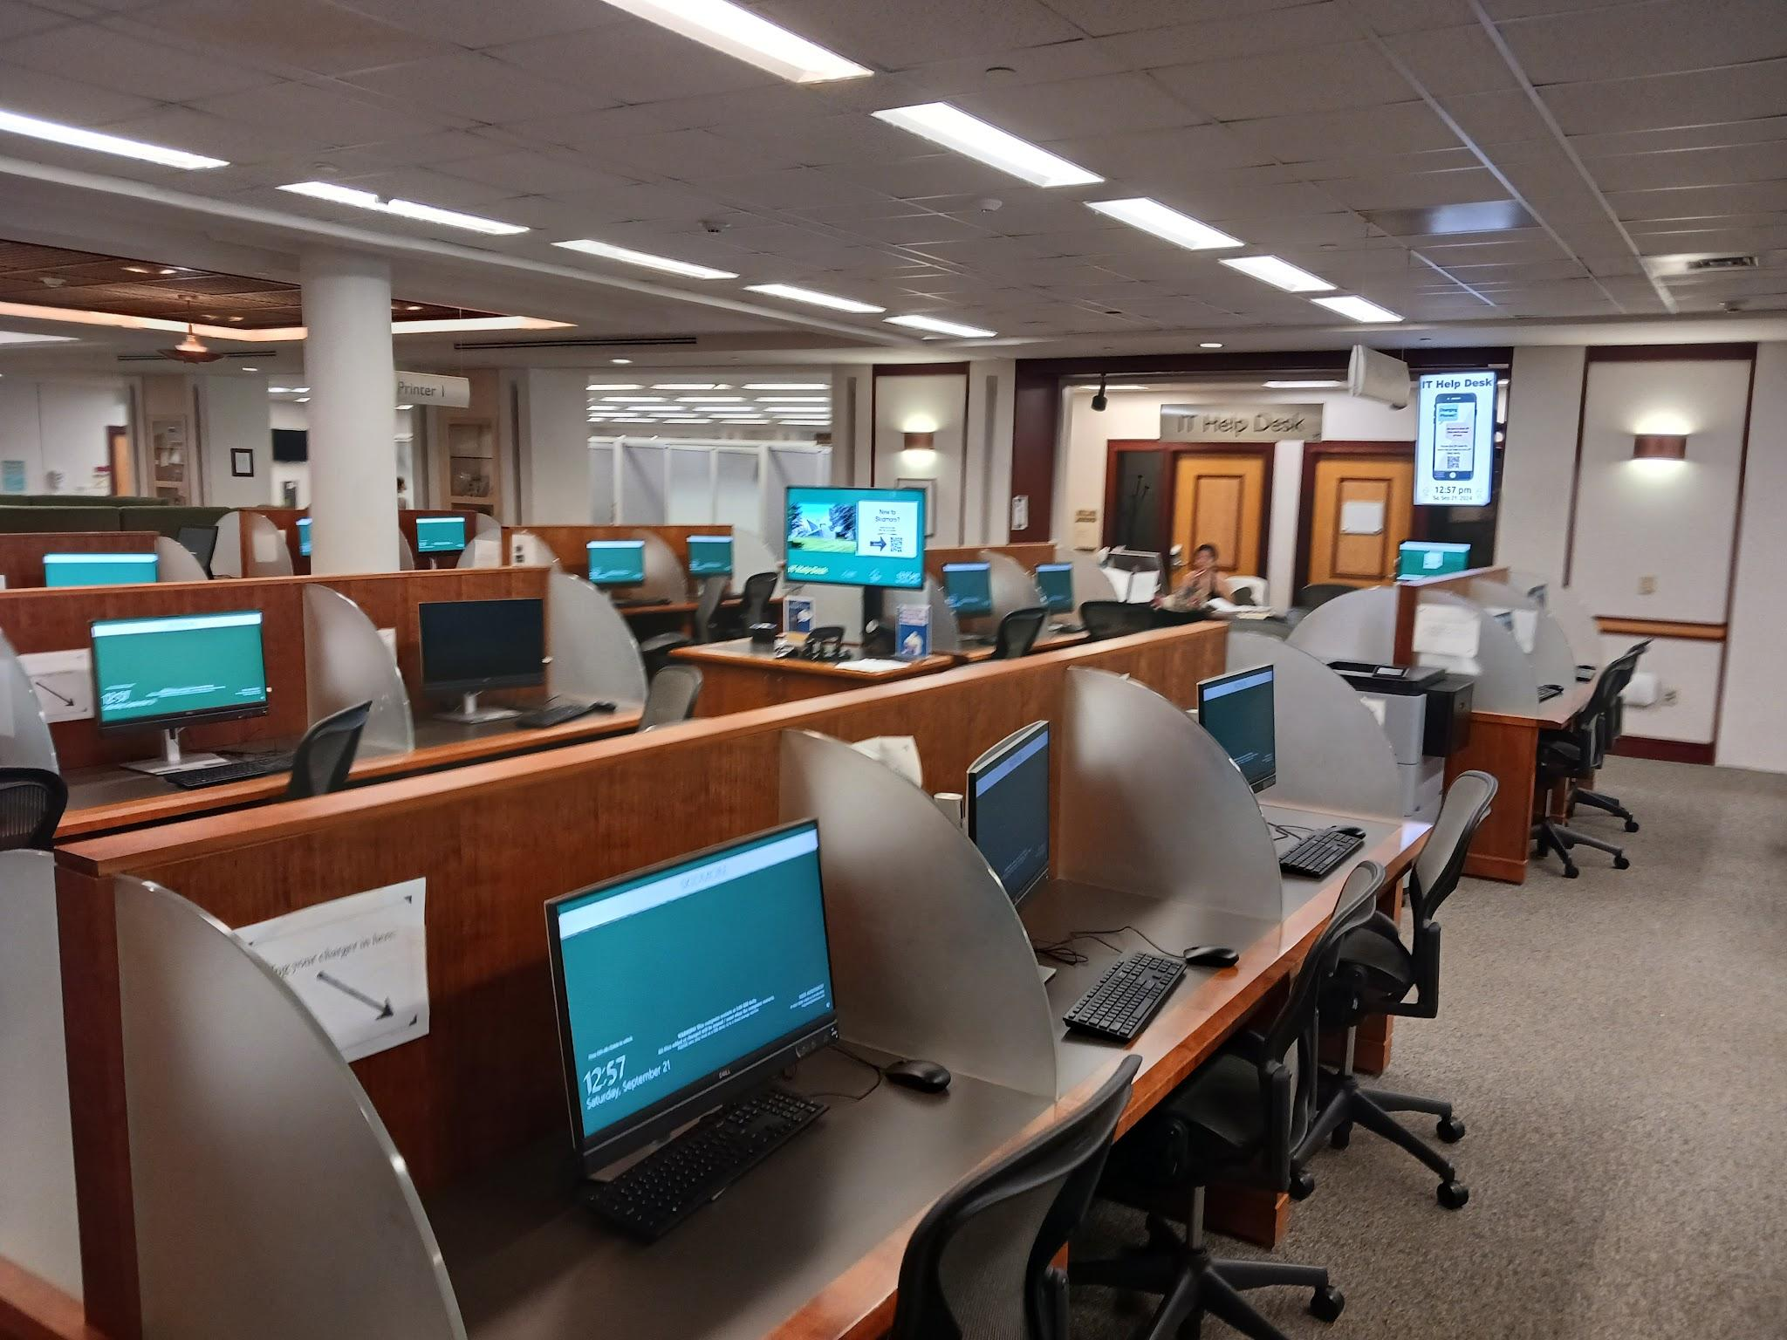
Library Computer and IT Help Desk

Slide 3

Picture This...
You work in an IT Department at a mid-sized community college. On the surface, screens are glowing and tickets are closing. But beneath the surface, a high-stakes game of "Mental Tetris" is happening every single day.

Slide 4

Single Points of Failure
The "Joe & Sam" Problem
Does Joe know where the projector refresh stands? Does Sam know Admissions is expecting access to a report from SUNY by Friday?
When knowledge isn't systemized, people become bottlenecks. The "Bus Factor" in the department is dangerously low.

Slide 5

The "Heroics-Based" Reality
Tribal Knowledge
The Attendance Gamble
Status updates live in spreadsheets, buried emails, and the leader's head. If you aren't in the room, you don't know the score.
Success relies on 100% attendance. If a key player is out, the project stalls because no one knows where they left off.
Information Silos
Reactive Stance
Data is trapped in personal folders and "sent" items. Collaboration is manual, slow, and prone to error.
Without a roadmap, the loudest voice in the room dictates the priority, leading to strategic misalignment.

Slide 6
The Cost of Invisibility
User Frustration: Forgotten details and missed deadlines erode trust across campus.
Technician Burnout: Working on wrong priorities leads to wasted effort and exhaustion.
Compounding Errors: Piles of projects stack so high that critical tasks slip through the cracks.
Time Waste: Endless "status update" meetings just to find out what everyone is doing.

Slide 7


Institutional Challenges
Staffing Shortage
Resistance to Change
Limited budget prevents new hires, while tenured staff favored legacy methods over standardized project management regimes.
Implementing a Project Management regime is difficult when resources are thin and historical resistance is high.

Slide 8
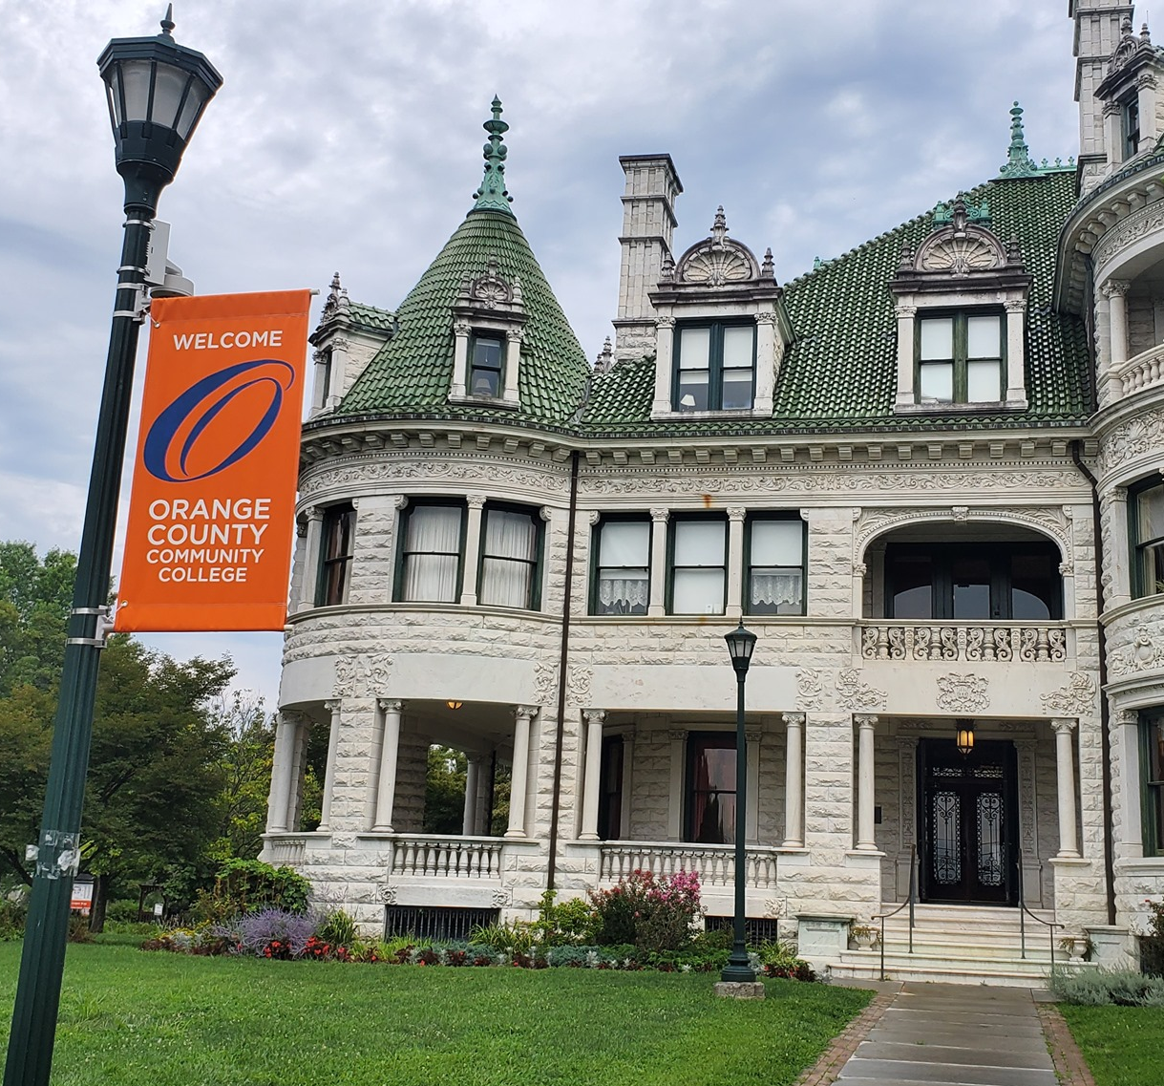
The Challenge:
How to Best Serve
the College
Overcome:
Turnover in leadership positions
Significant staff shortage
Being new to the role of director

Slide 9
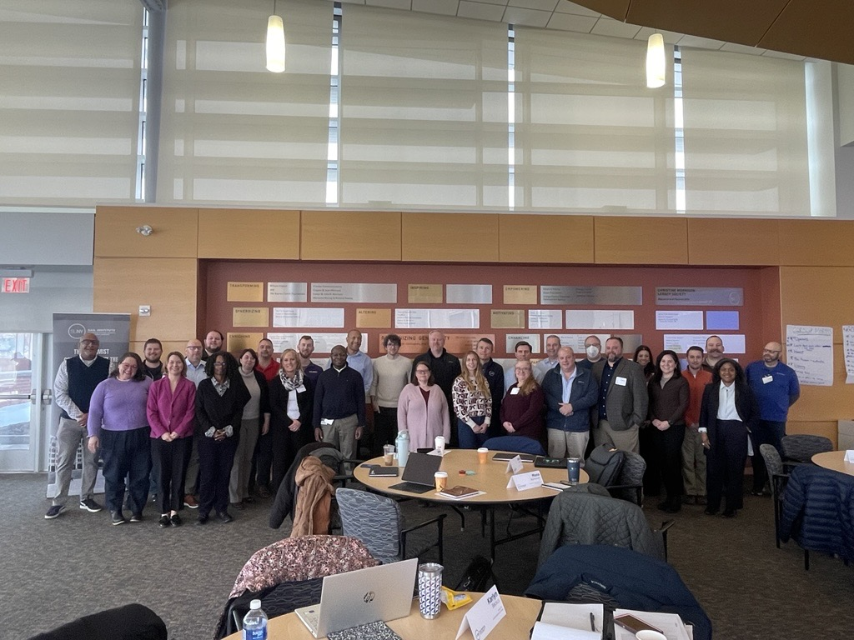
The Leadership Transition
Growth and Confidence
Transitioning from a technical expert to a strategic director requires more than a title—it requires a fundamental shift in perspective.
The CIO Academy provided the tools, theory, and professional community to bridge this gap, transforming technical proficiency into leadership confidence.

Slide 10

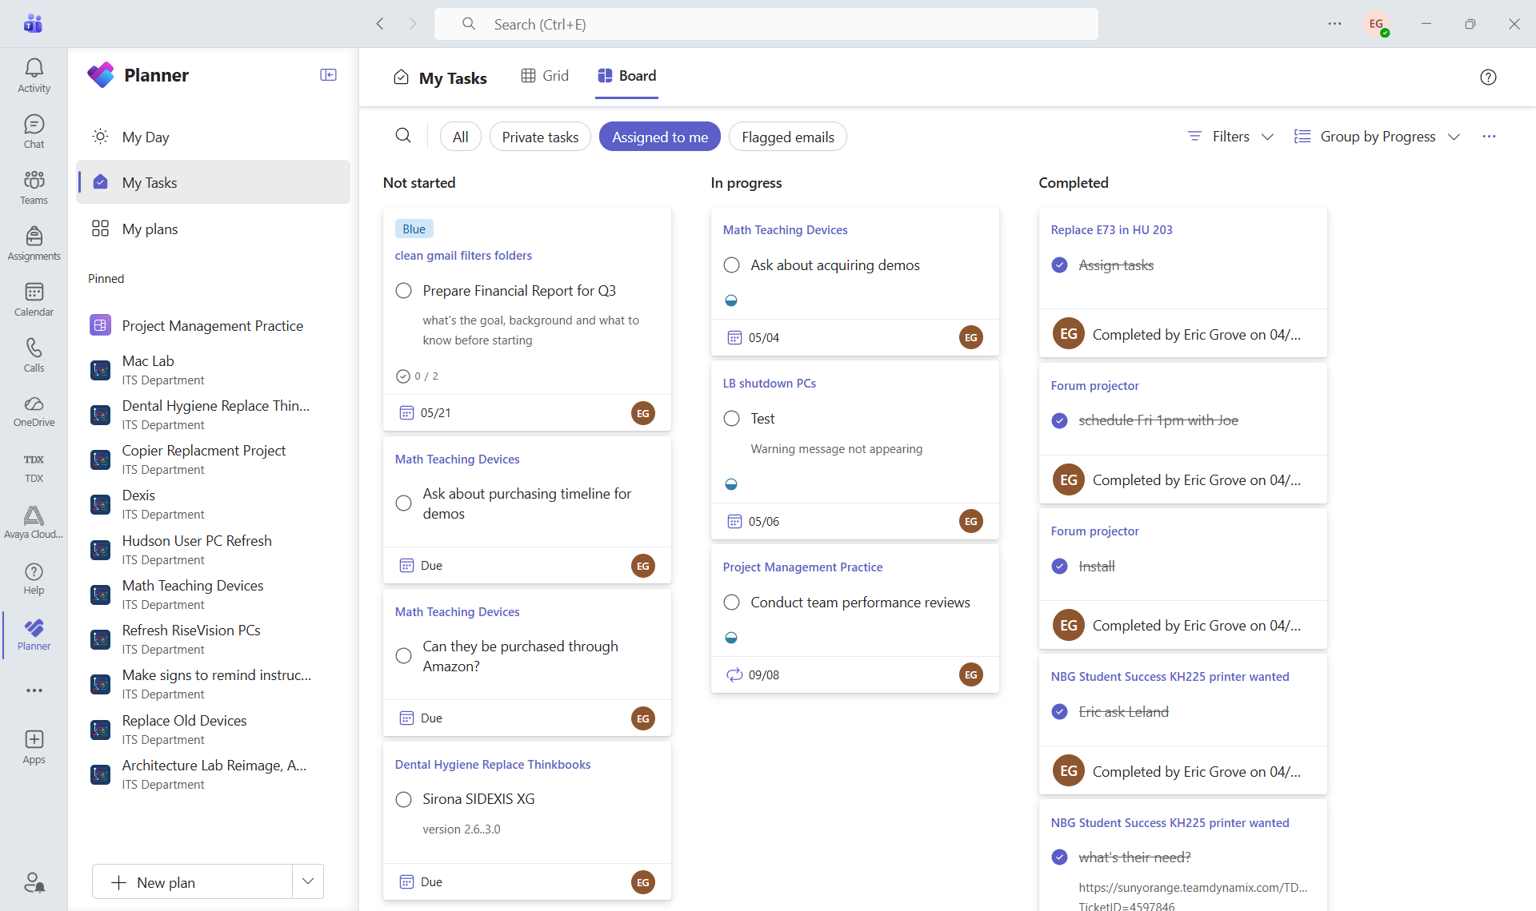
Low Friction Implementation
Leveraging Existing Tools
We chose Microsoft Teams Planner to minimize adoption friction. As a tool already included in our licensing, it offered a Trello-like Kanban experience without the "tool sprawl."
It allowed for assigning tasks, setting due dates, and providing staff with a clear view of exactly what they need to achieve for the day.

Slide 11



Cultivating Team Buy-In
Solve Their Pain
Start Small
Lead by Example
Launch one high-visibility project first. Let the team feel the "win" of organization.
If it's not in Planner, it doesn't exist. The leader must be the first user.
Frame it as a way to stop hallway interruptions and status check-ins.

Slide 12






The Power of Transparency
Centralization
Absence Coverage
Daily Focus
Removing "hallway updates" and replacing them with a single source of truth for all projects and task statuses.
When someone is away, the work doesn't stop. Teams Planner ensures progress is visible and tasks can be picked up by others.
Staff see exactly what they need to do for the day, reducing cognitive load and increasing measurable output.

Slide 13
Mastering the Circle of Control
Strategic Focus
A key CIO Academy lesson: I cannot control the college budget or the pace of retirement. I can, however, control our operational tools, our internal transparency, and the way I motivate my direct reports for a shared goal.
CONCERN VS. CONTROL

Slide 14
Building the plane while flying
"We are building the plane while we are flying it. It is a difficult exercise, but it is necessary to meet the college's mission."
— Leadership Reflection

Slide 15
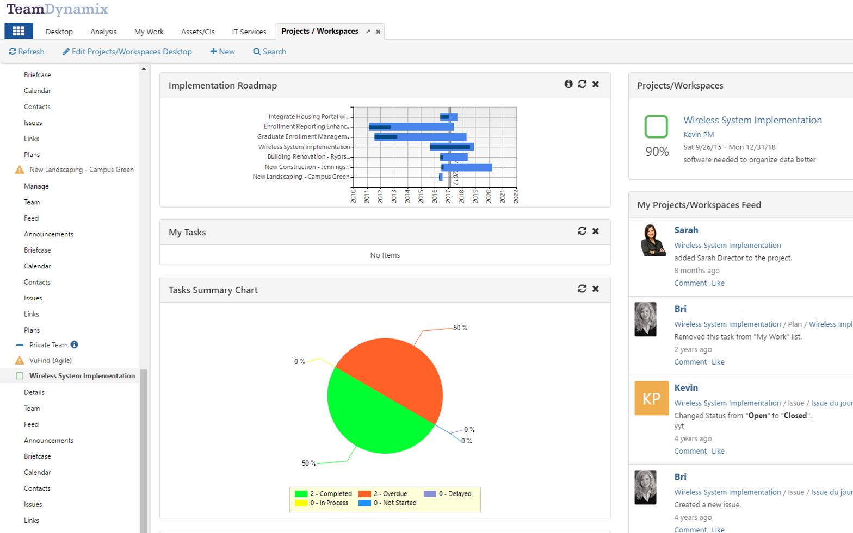
The Bridge to TeamDynamix
CRAWL, WALK, RUN
Planner is our "Project Primer." It builds the requisite culture and discipline needed for enterprise PPM.
THE MIGRATION GOAL
Once available, we will migrate to TeamDynamix (TDX) to leverage full portfolio management, resource leveling, and integrated service desk data.

Slide 16
Roadmap to Maturity
Phase 1
Phase 2
Phase 3
Phase 4
Teams Planner: "Dipping our toe in" with visual tasks.
Culture Shift: Normalizing accountability and deadlines.
TeamDynamix: Moving to enterprise-level PM.
Operational Excellence: Proactive institutional support.

Slide 17
Leading with Confidence
Know myself, my skills, my institution and my team
Talent x Investment = Strength
Navigating the change curve

Slide 18

Confidence for the Future
I am incredibly grateful to the SAIL Institute and the CIO Academy. These lessons haven't just shaped my projects—they've defined my leadership.

Slide 19
Questions?
Thank you for your time and for being part of this journey.

