Slide 1


CIO Leadership Academy Applied Learning Project

Slide 2


Implementing Ticket Priorities
Peter Dawes
Assistant Director – Technology Help Center
SUNY Cortland

Slide 3
Explanation of the Project
Our ticketing system was not set up to assign priority to tickets, which leads to difficulty in workload management.
To address this we created a plan to use ITSM best practices to assign ticket priority based on impact and urgency
Notes:
New executive leadership on campus: a great time to uncover “we’ve always done it that way” situations where there is room for improvement
Several suboptimal ticketing practices were uncovered, many stemming from a lack of formal service level objectives which is due to a lack of prioritization
We used the “major incident” classification for large outages which served as a sort of prioritization, but the other 99% of tickets defaulted to “normal” priority

Slide 4
ITSM Standards
Impact: Extent of disruption to users
Urgency: Extent of disruption to business
Priority: Relative importance of the ticket to the organization
Responded: The ticket has been acknowledged and begun initial handling
Resolved: The underlying issue has been fixed or the service is restored
Service Level Objective: Target timeframe for responding and resolving issue
 | Low | Medium | High
Single User | Low | Low | Normal
Small Group | Low | Normal | High
Large Group | Normal | High | High
Whole Organization | Normal | High | Critical
Priority | Response | Resolve
Low | 8 | 40
Normal | 4 | 16
High | 2 | 8
Critical | 1 | 4
Notes:
TeamDynamix has built in prioritization based on standard ITSM practices, they simply were not set up at implementation
The big lift is determining how things like impact and urgency get set on a ticket and how the terms are defined for our usage:
What is a small group vs a large group? What does “medium urgency” actually mean?
Cannot ask an end user “what is the urgency” and have them respond “medium” and have that be a consistently applied standard
For user facing ticket intake need an objective question with a consistent set of answers:
“what is the impact on your work?” “no impact, slowed down, or completely stopped” translate to low, medium, high urgency
could mark a ticket as ‘critical’ today and it wouldn’t change anything about how the ticket is processed because there is no configuration to enable it to, will require redesigning technician dashboards to be built around priority and SLA. Technicians will need to adopt ticket handling practices to ensure the tickets are marked as responded and resolved

Slide 5
High Performing Teams
I built support at both the leadership and technician levels by aligning the change to the interests of both groups.
With management, I kept the process focused on simple, scalable ITIL standards to avoid overengineering the priority model.
With technicians, I framed the change as a tool for clearer expectations, better workload visibility, and more consistent triage rather than additional oversight.
Notes:
Two distinct groups involved with this implementation;
management whose role it is to define the standards and technicians who need to adopt new ticket handling processes to meet those standards
With management we need to focus on a vision: what outcome are we trying to achieve.
---Set up system to accommodate that outcome---
With technicians we need to focus on process, how do you create tickets that will set appropriate priority, how do you now use these priorities to change work habits.

Slide 6
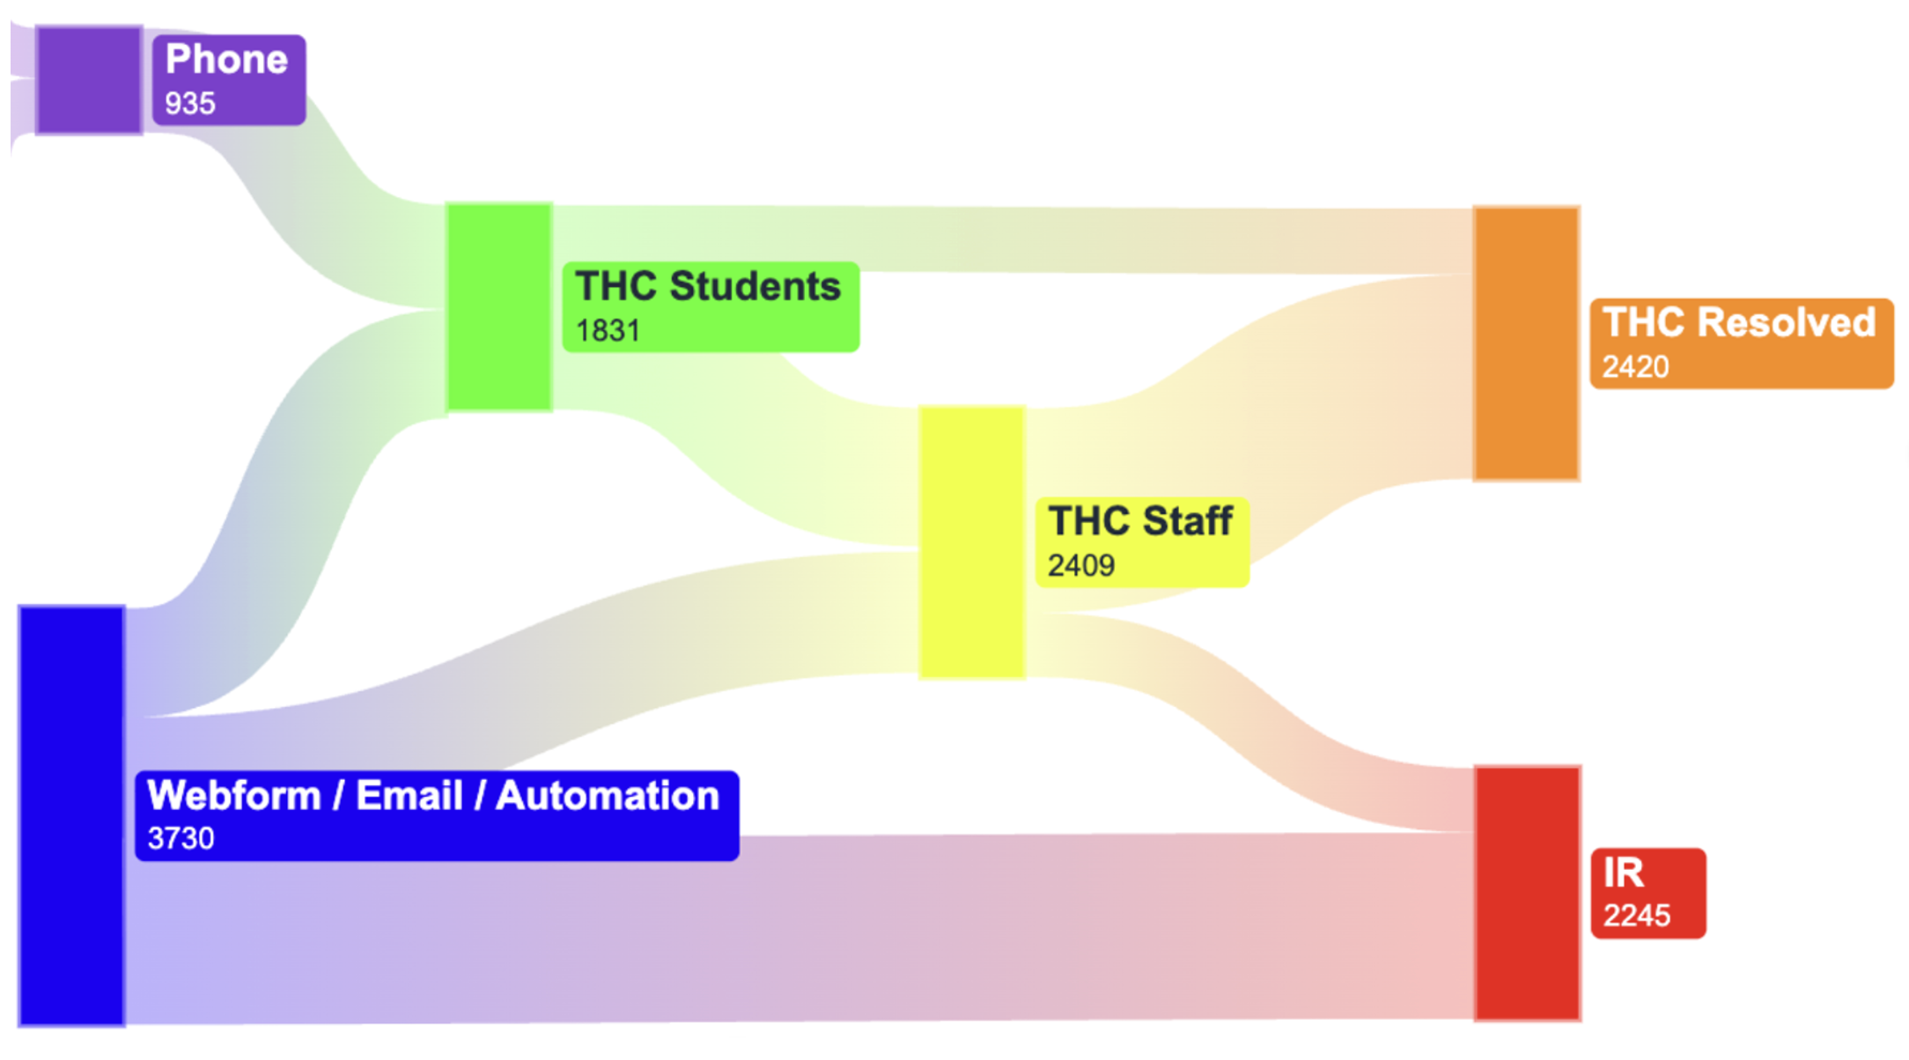
Overcome Obstacles – Right Sizing
Define what our goals are and how the ITSM definitions can be used to meet those goals
Focus on a plan that works for majority of tickets
Talk about edge cases after that plan is set, and ensure checks are in place for them
Notes:
With management we need to focus on outcomes, not system
A group of people can spitball ‘what if’ scenarios all day and end up focusing on edge cases
The goal should be to first design a system that works for the majority of cases, and when that is well defined think about edge cases
A data driven approach is needed to create alignment on where our focus should be for design related questions
Example: A lot of focus was initially placed on how students at the helpdesk would set priority for phone calls, and how priority would be reviewed prior to escalation from the helpdesk
Sankey diagram of ticket flow shows this is only a small portion of incoming tickets are generated over the phone, many of which are one call resolution and that the majority of tickets going through helpdesk are solved without escalation. Tier 3 tickets are largely from a small number of webforms and automations, where we can design default priorities

Slide 7
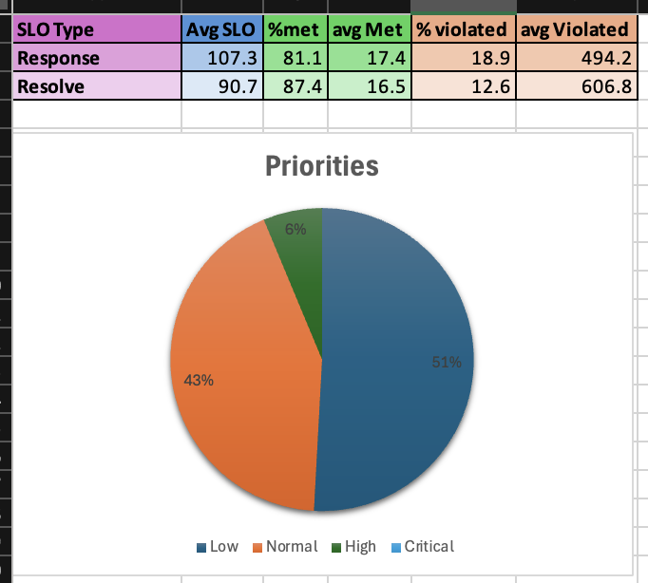
Overcome Obstacles –
Technician Adoption
How will this impact how I am managed and How I manage my own work?
Will this create extra work?
Notes:
Change adverse technicians may see the additional oversight SLOs enable as “micromanagement”
Some emphasize that the system was working before without the “extra steps”
Others expressed concerns about how tickets where the SLO expired for reasons beyond their control would reflect negatively on them
Before the initial meeting to announce the plans for the change, several days worth of tickets were exported, had the prioritization rules applied, and then were evaluated on how they would have met SLO had it been applied
Results showed that we actually over-prioritize around half of tickets under the current system. And that we are already consistently meeting proposed SLOs without even trying
An analysis of the violated SLO tickets showed that this was largely due to bad ticket handling practices that SLOs would have actually prevented IE leaving a resolved ticket in an in-process status for weeks after the requestor indicated it was fixed.

Slide 8
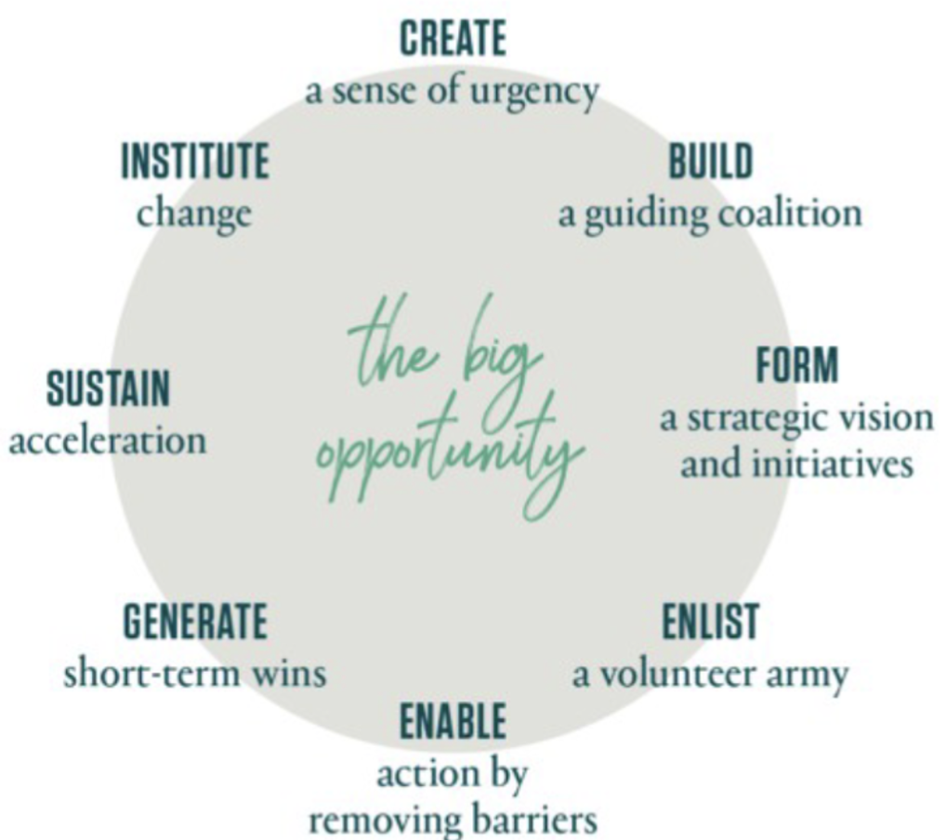
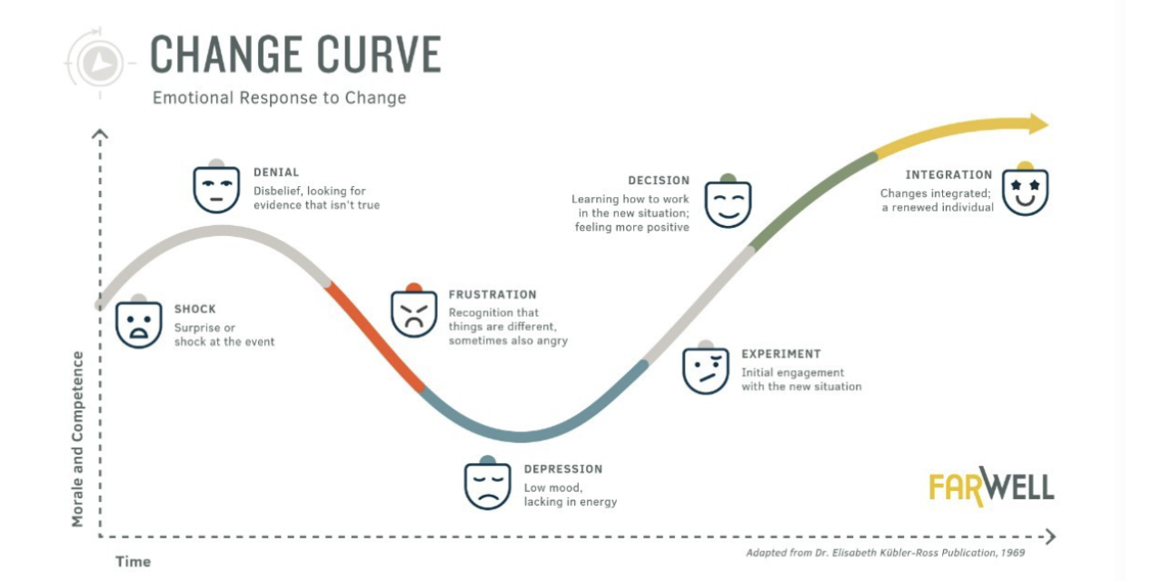
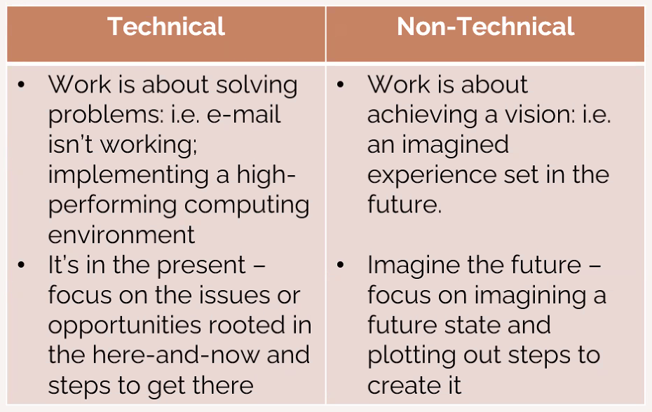
Final Thoughts and Reflections
Notes:
As I went through the course I pulled out screenshots from some of the presentations that resonated with me
These are my top three
Kotter change framework served as a template for my process
The technical vs non technical conceptualization of work was very relevant to framing conversations with technicians and management teams.
The change curve is something I watched in real time during the technician meeting regarding the plan

