Slide 1
SUNY CIO Leadership Academy
Applied Learning Project
Defining an Invisible System; Proposing Digital Governance
Recognizing strengths, aligning opportunity.
Kari D’Amico
IT Project and Contract Manager
Buffalo State University
May 2026

Slide 2




SETTING THE STAGE

Slide 3




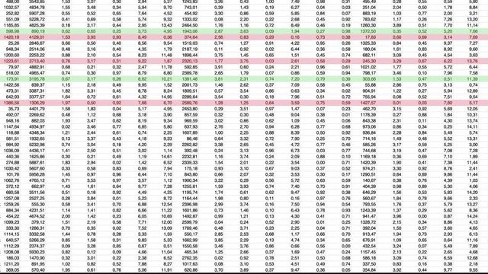
THE FOUNDATION

Slide 4


THE OPPORTUNITY

Slide 5

CAPSTONE PROJECT

Slide 6



Slide 7


WHY NOW?

Slide 8

OBSTACLES
me

Slide 9


REFLECTIONS

Slide 10
