Slide 1
Getting Animated About Automation
Paul Christofel
Service Desk Coordinator
SICAS

Slide 2

SICAS
A shared services organization that provides IT, Training, and Technical Support for Ellucian Banner, DegreeWorks, Evisons Argos, and more
Support 75 New York based institutions
Staff of 60 Employees across 6 Teams

Slide 3
Providing Campus Support
Notes:
Ticket Resolution by Year
2023 – 3025
2024 – 6476
2025 – 6806
2026 – 2292
Need for Automation – improve efficiency.
Why its going to help us/ help the campus
Everyone is being required to do more with less, so how can we provide better support for you

Slide 4
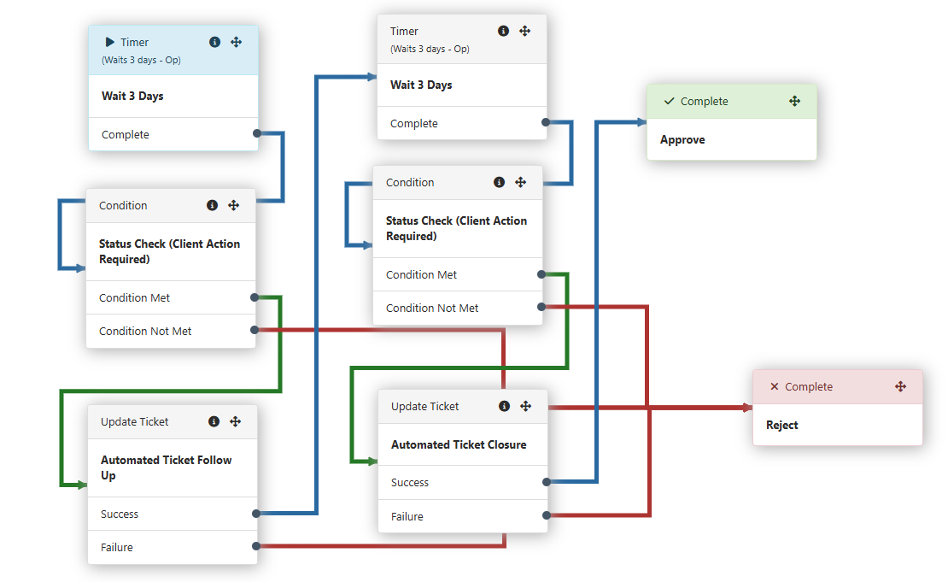
Check-in / Closure Workflow
Notes:
Explain TeamDynamix Workflow
Manual Check In Update > Assign Workflow *Human Update*
Wait > Status Check > Automated Ticket Update Check In *System Update*
Wait > Status Check > Automated Ticket Update Closure *System Update*
People first mentality. No ticket left behind. Several opportunities for the campus to respond.

Slide 5

How We Got There
Provide a space to gather information
Snowball Effect – start small and gather momentum
If you build it, they will come… or one can hope
Notes:
Started small - use the Frontline Team.
Establish a group consensus for this effort
Provide the space for feedback.
Build it, come back, adjust and publish
Get excited, convince people that this will help

Slide 6
Problems
Organization & Leadership Changes
Avoid Any Additional Disruptions
People Became Reluctant
Day to Day Distractions
Notes:
Organizational Changes. People panicked about the unknown from the organization. Focus shifted. Reluctant to change.

Slide 7


Solutions
Trust The Process
Lead By Example
Keep Looking Forward
Just Keep Swimming
Notes:
Small wins = Progress. Progress over time = outcomes.

Slide 8
What is Next?
Scale It – Team to Organization
Improve & Expand
Utilize iPaaS to Grow Automation
Notes:
iPaaS – Integration Platform as a Service
Account Creation, Listserv Additions, other routine tasks.

Slide 9

Final Thoughts / Reflection
Change Takes Time
Moving one step forward is still progress, no matter the size of the step
“We keep moving forward, opening new doors, and doing new things, because we’re curious and curiosity keeps leading us down new paths.” –Walt Disney

