Slide 1
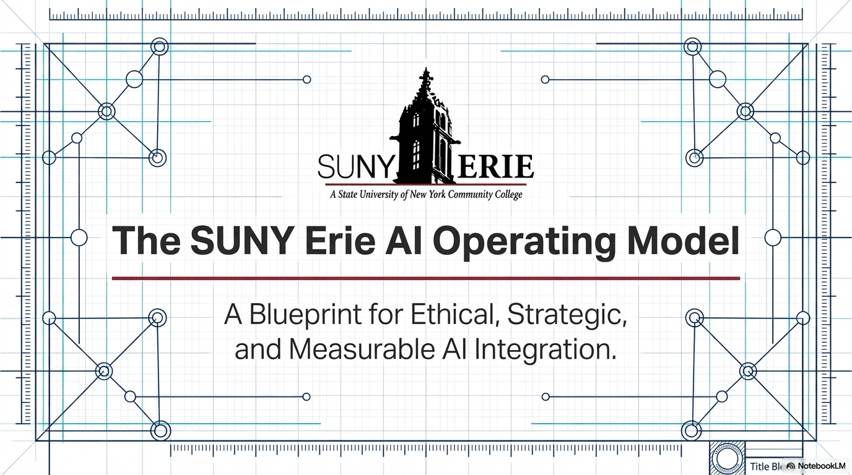
Notes:
This project reflects how I applied CIO Leadership Academy principles to being the processing of moving SUNY Erie from fragmented AI experimentation to a governed, ethical, and sustainable institutional strategy.
Let me start with why this work was necessary

Slide 2
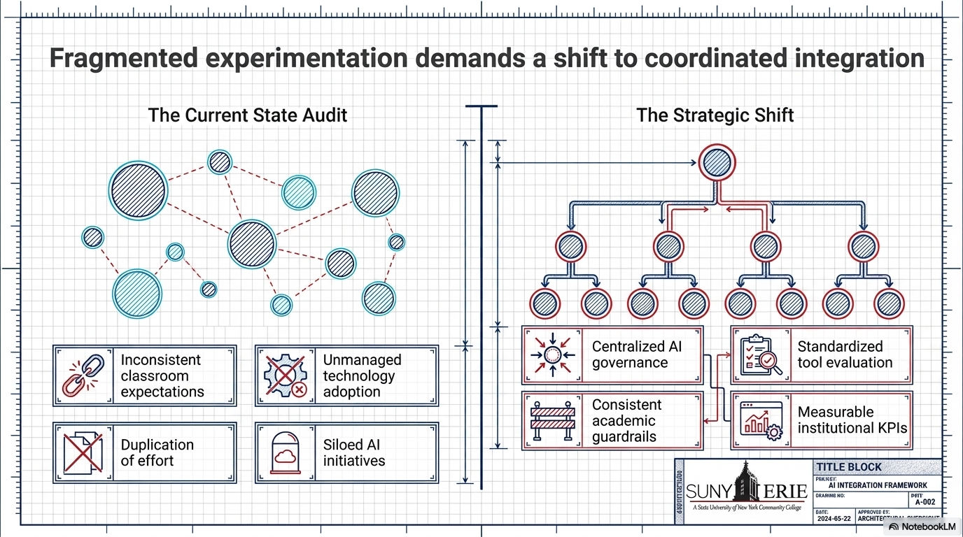
Notes:
AI adoption was already happening across SUNY Erie—but it was uneven, inconsistent, and largely uncoordinated.
Faculty and staff weren’t asking if they could use AI—they were asking how to use it responsibly.
At the same time, the institution faced real risks around privacy, academic integrity, and equity.
This created a clear leadership gap—and an opportunity.
So instead of reacting to AI, I focused on building a structured, institutional response
This project was an effort to bring structure to that reality.

Slide 3
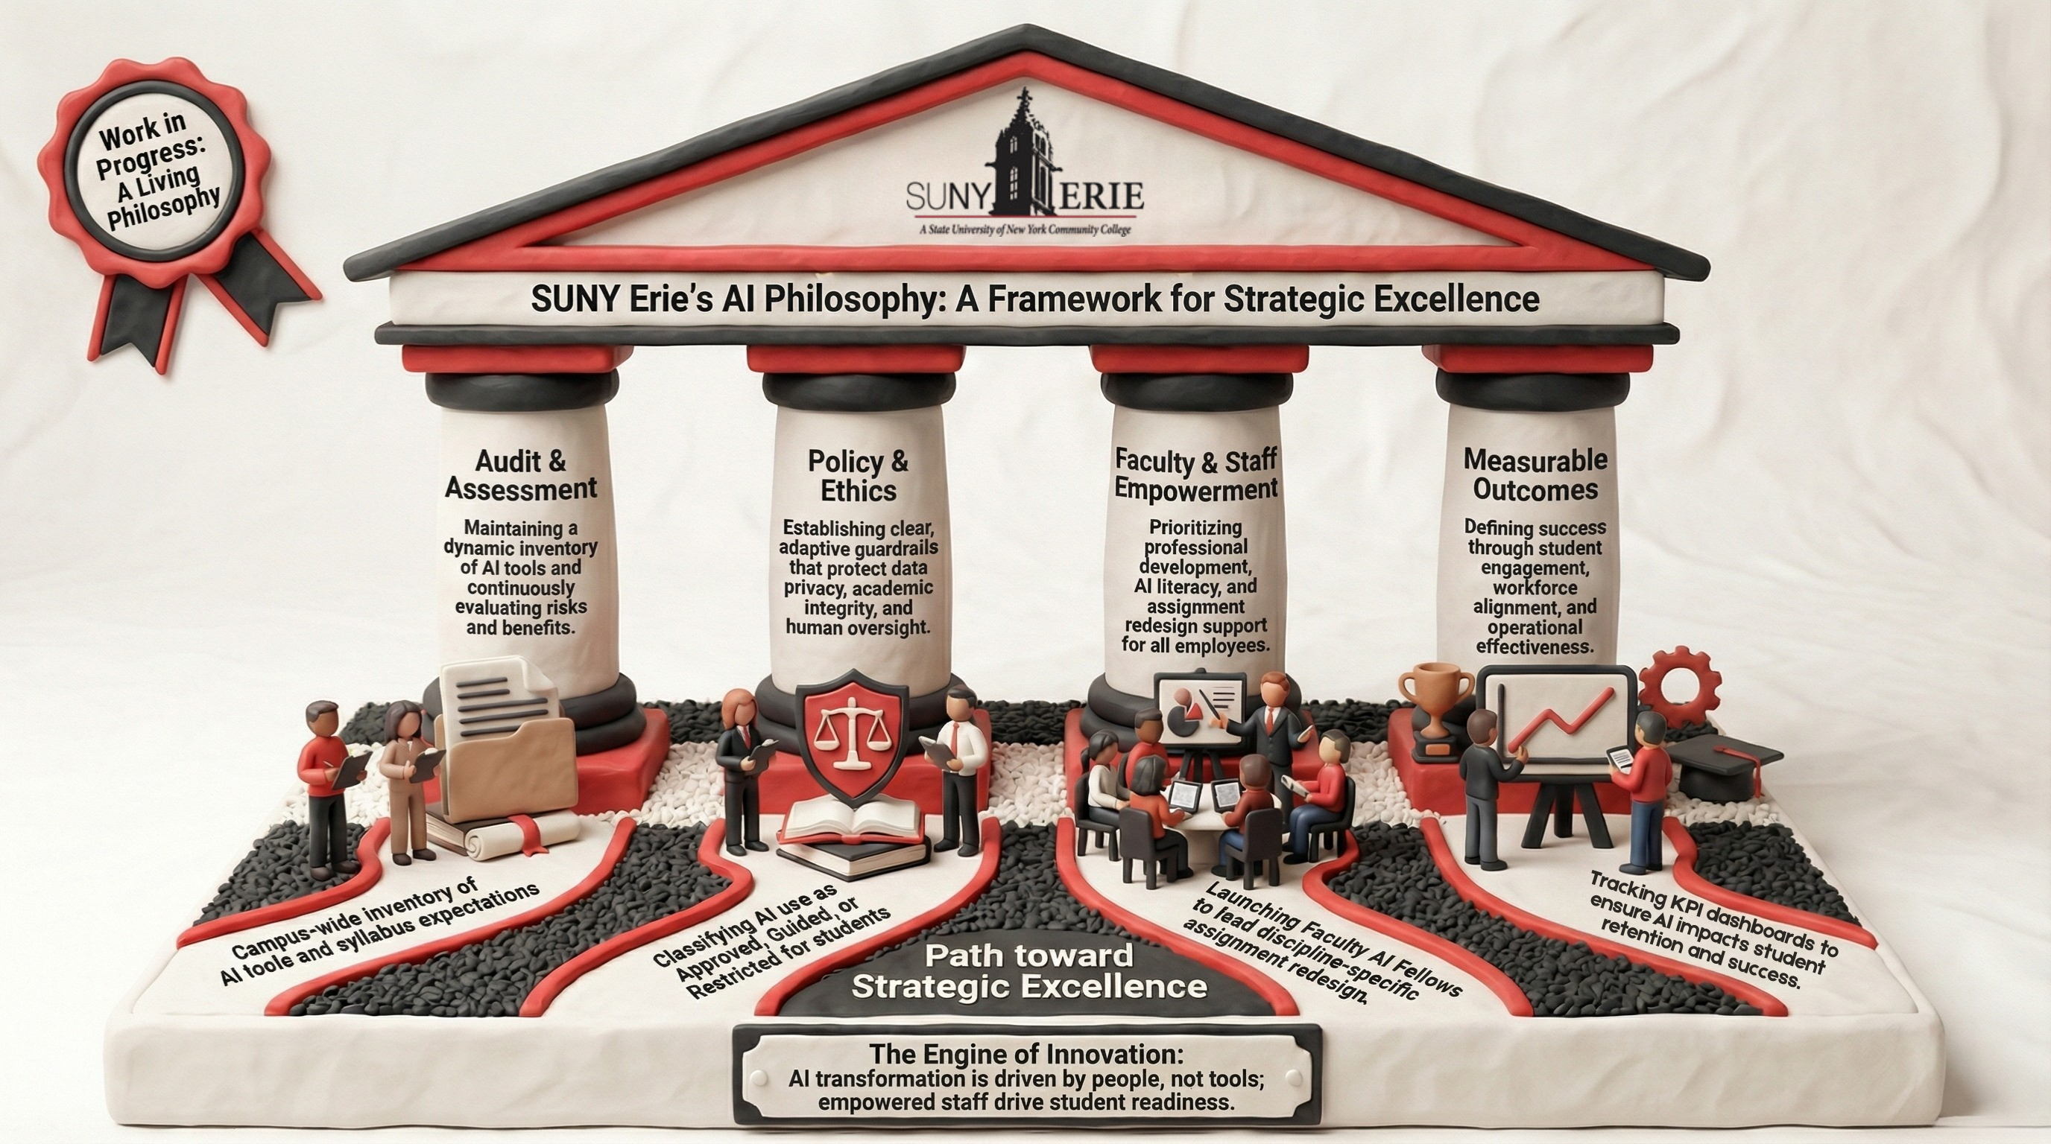
Notes:
As part of this project, I developed a draft institutional framework to guide this work.
First, Audit and Assessment—understanding what was actually happening
Second, Policy and Ethics—creating guardrails without limiting innovation
Third, Empowerment—building faculty and staff capacity
And fourth, Measurable Outcomes—ensuring this work is sustainable and accountable
This framework ensures we’re not chasing tools—we’re building institutional capability.
And I started this work intentionally—with listening

Slide 4
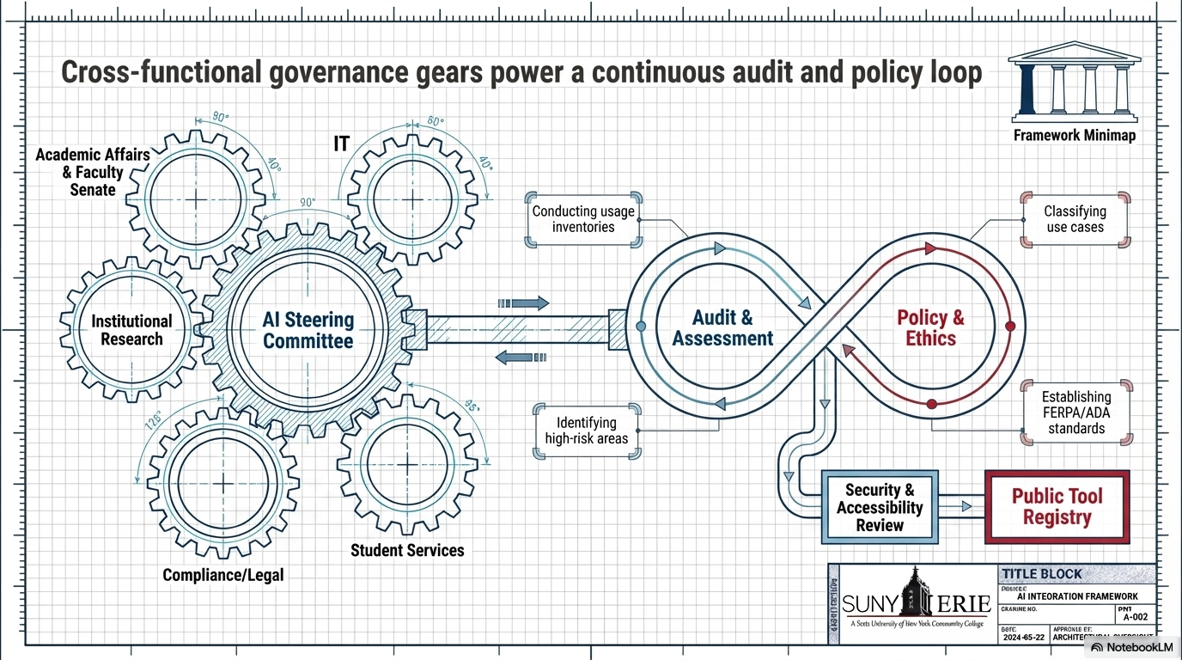
Notes:
As part of this work, we launched an institutional AI survey, which is currently in progress.
This survey is helping us move from assumptions to data‑informed decisions around AI use, access, and concerns
ECC AI Survey will help us understand actual use and concerns, identified gaps in access, literacy, and ethical understanding, My goal is to use data—not assumptions—to shape the strategy.
Governance enables innovation—it doesn’t restrict it.
Cross‑functional steering committee
Clear review and approval process
Transparent ownership and accountability
Balancing Academic Integrity, Equity, and Risk
Faculty desire for AI detection tools
Risk of false positives and equity concerns
Leadership decision: limit high‑stakes reliance on detection
Shifted focus from policing → learning and process

Slide 5
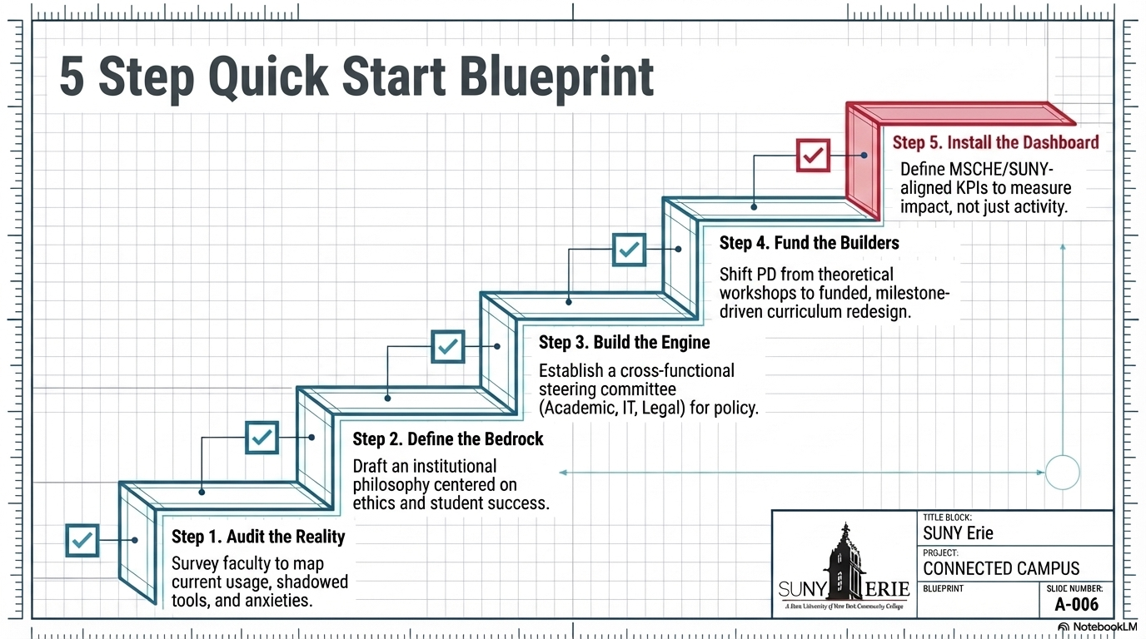
Notes:
This framework outlines a governance model we are in the process of implementing.
Balancing Academic Integrity, Equity, and Risk
Faculty desire for AI detection tools
Risk of false positives and equity concerns
Leadership decision: limit high‑stakes reliance on detection
Shifted focus from policing → learning and process

Slide 6
Lessons Learned
Self-Awareness
Greater awareness of my leadership tendencies
Recognition of patterns that impact team effectiveness
Key Growth Areas
Identified tendency to become overly analytical or detached
Need to strengthen strategic follow‑through and clarity of action
Balancing independence with stronger engagement and alignment
Leadership Shift
From “leading through logic” → to “leading with awareness and impact”
From reacting quickly → to intentional, structured decision-making
Notes:
One of the most impactful parts of the Academy was the level of self-awareness it required.
Tools like Positive Intelligence and 360 feedback really held a mirror up for me as a leader.
I recognized patterns in how I show up—particularly a tendency to become overly analytical, to distance myself when things feel unclear, and at times to move forward without fully bringing others along in the process.
What that means in practice is that I can be very effective at solving complex problems—but if I’m not intentional, I can miss how the team is experiencing the work.
The Academy helped me reframe these not as weaknesses, but as overused strengths—what Positive Intelligence calls saboteurs.”
So my focus now is being more intentional—slowing down when needed, creating clearer action steps, and staying more engaged with the team throughout the process.
That shift—from purely analytical leadership to more balanced, self-aware leadership—has directly influenced how I approached this AI initiative.
This awareness is something I will continue to actively work on as I grow into a CIO-level role.

