Slide 1
A Better Use of MS Teams in Projects
Capstone Project for the CIO Leadership Academy
Phil Vecchione
Director of Project Management

Slide 2
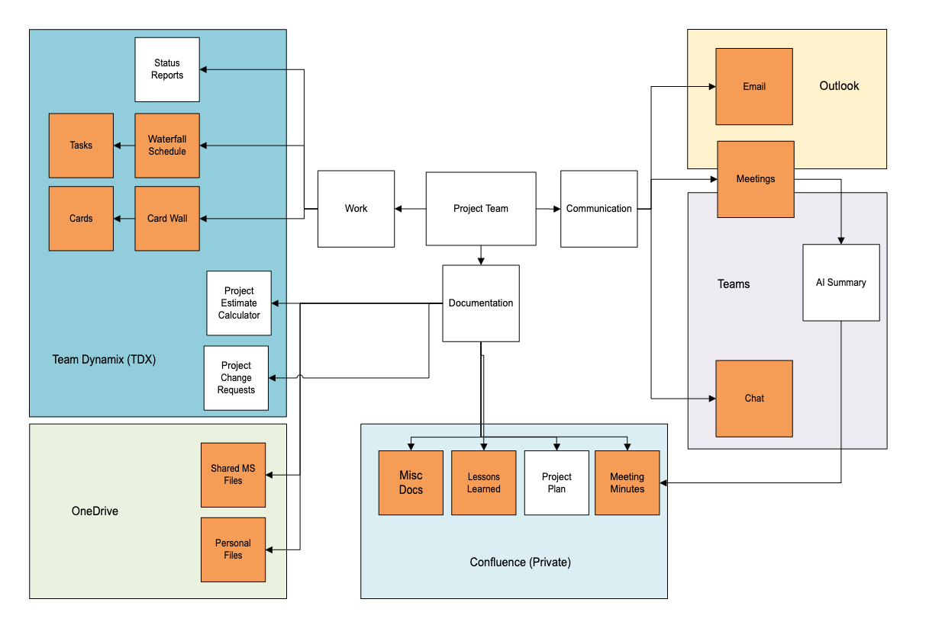
ITEC Projects – Apps and Data

Slide 3
Problem 1 – App and Data Sprawl
For project team members, data for a project is spread out over several applications. Each with…
Their own organizational system
Their own permission structure
Their own notification system
Team members do not always know where to go to find information within each system
Team members' time is better spent on technical tasks than on trying to find project information

Slide 4
What if we could create a single jump-off point for all the information a project team member needed?

Slide 5
We already have one…Microsoft Teams.
It’s an integrated platform for team collaboration, serving as a hub for communication, meetings, and file sharing.

Slide 6
Problem 2 – Teams Implementation
ITEC did not migrate into Teams with any implementation plan nor training
Because of this, we do not fully utilize the MS Teams application and its integrations.
Today, it is used mostly as a chat application and for meetings.

Slide 7
Framing The Project
Color | What does the work look like? | Implementing a standard Team structure for projects that consolidates information into the application. “One stop shopping”
Context | Why are we doing this? | Make it easier for team members to find project materials. Makes work more efficient Reduces questions/delays Improves compliance
Connective Tissue | What will be impacted by this? | Project Teams, Project Managers, PM Processes, Security Team, Windows Admins
Cost | Money, Time, Effort, Bandwidth | Effort – Focused on the PMO
Consequences | If this is not done on time? Risks? | Low-None. We have a system in place already.
Brene Brown’s – 5Cs

Slide 8
The Project Plan
Teams Knowledge
Creating a Prototype Team
Training Our PMs
Amending PMO Processes
Training our Project Teams
Pilot Projects
Full Rollout
January - April
April - August

Slide 9
Teams Knowledge
Features
Templates
Archiving
Notifications
Best Practices
Use for Projects
Research:
MS Documentation
Blog Articles
YouTube
Informal conversations with management and team members to get initial feelings

Slide 10
Our Prototype Team
Meeting Minutes
Meetings
Lessons Learned
Waterfall
Schedule
(link)
Shared Files
Main Channel
Misc Docs
Milestones
Card Wall
(link)
Project Plan
Breakout Channels
Team Notebook
Team Calendar
File Repository
Home Page
Notes:
Centralize all the things that a team member needs inside Teams.
Some applications can be replaced with Teams features.
Some things we can’t move, but we can create links.
Anything a team member needs to know/find, they start with the project Team.

Slide 11
Pilot Projects
Manually deployed Teams Design for 2 projects
Trained project teams
Have a Team Question Channel
Actively engage teams and observe usage
Conduct lessons learned and gather feedback

Slide 12
The Project Plan
Teams Knowledge
Creating a Prototype Team
Training Our PMs
Amending PMO Processes
Training our Project Teams
Pilot Projects
Full Rollout
January - April
April - August
September - January

