Slide 1


2025 CIO Leadership Academy Applied Learning Project
Notes:
INTRODUCTION- Background

Slide 2

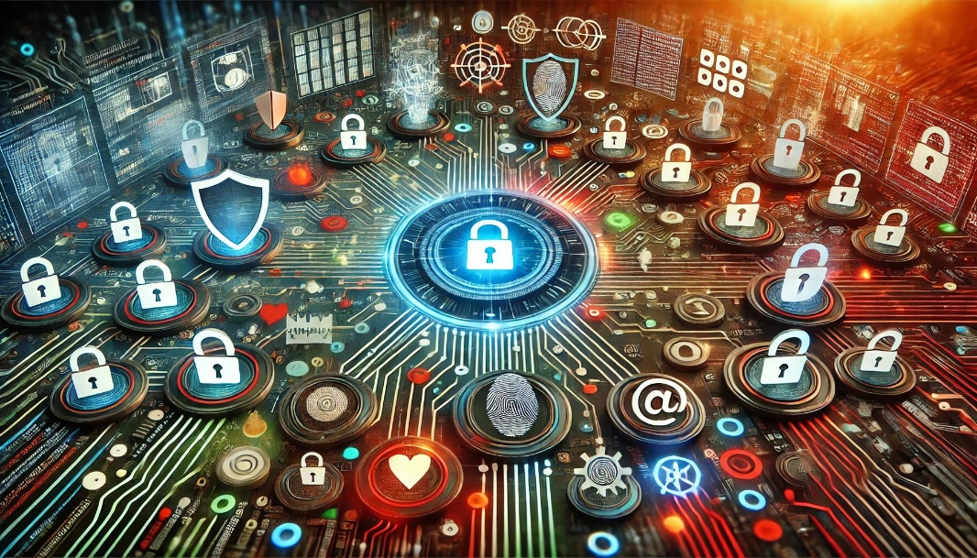
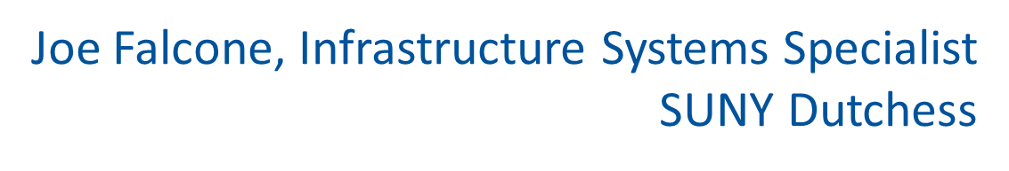

The Power of Alignment:
Unifying Cybersecurity Efforts into a Strategic Initiative

Slide 3
Explanation of the Project
Objective: Leverage my passion for cybersecurity to address critical gaps in system configurations by integrating best practices and fostering institutional support.
Why: Genuine concerns and lack of dedicated positions to handle these critical workloads.
Expected Outcomes:
Technical: Enhanced security measures
Cultural: Improved cybersecurity awareness
Sustainable: Institutional recognition and funding for cybersecurity initiatives.
Notes:
/ Succinctly state: What are you trying to do? Why? And what are the expected outcomes?

Slide 4
The Project(s)
“Work in M365 cloud environment” - Became Global Admin, asked to Maintain and Optimize
  Engaged CISA for free Cyber Hygiene and Penetration Assessments
  Initiated routine internal Phishing campaigns and community training
  Established dedicated IT space in our main newsletter to improve campus outreach
  Implemented conditional access policies allowing self-remediation of sign-in and user risk
  Improved Microsoft Security Score by over 35% vs. similar sized organizations
Notes:
/ Succinctly state: What are you trying to do? Why? And what are the expected outcomes?

Slide 5
18 Months Later (Now)
“Joe handles security” – A recognized voice with a seat at the table
  Address cyber incidents
  Steer monthly cybersecurity meetings
  Played instrumental role in passing GLBA Audit
  Co-wrote official response to SUNY ISP 6900
  Manage Security Awareness Program
  Presidentially appointed to AI Taskforce Committee
Notes:
/ Succinctly state: What are you trying to do? Why? And what are the expected outcomes?

Slide 6
The Next 18 Months?
Continued partnership with executive leaders on enterprise initiatives:
  Secure Email Gateway
  Campus-wide Business Impact Analysis Survey
  Conducting Annual Tabletop Exercises
  Adoption of NIST CSF 2.0 Standards
  Transitioning into a newly developed Cybersecurity role
Notes:
/ Succinctly state: What are you trying to do? Why? And what are the expected outcomes?

Slide 7
How did I foster a constructive team climate?
Inclusion and outreach – Translated technical cybersecurity needs to key stakeholders using business language. Reinforcing IT as a business enabler.
Consistent communication- Held weekly security meetings, supplemented by emails and in-person discussions. Repeating and reinforcing core concepts.
Built trust by leveraging 3rd party validation - Vulnerability assessments from our vISO and CISA praised our security controls.

Slide 8
Obstacles and Challenges
Pushing through the inherent resistance to change – earning trust can be slow
Bureaucratic barriers – difficult to lead and shape culture as a "Specialist"
Approaching and Overcoming:
Collected easy-wins to gain trust and display competency
Articulated my intentions, speaking with confidence and stayed the course
Leveraged credibility to work on more impactful projects

Slide 9
Final Thoughts and Reflections
Always ask questions, never assume you know your stakeholders
Ignore titles. Instead, adopt perspectives
Simplify your objective and focus on delivery
Confidence comes from aligning your passion and purpose
In summary, lead with the 4 P’s:
People – Perspective – Passion - Purpose

Slide 10
THANK YOU to Carolyn J. Mattiske, Christy Rohmer and SUNY SAIL/NYSERNet for this amazing opportunity.
S/O Mentor: Garrett McAlister, CIO SUNY Westchester
Congratulations to all our future IT leaders!

