Slide 1
ESF IT Services ITIL Analysis
Jennifer Webb
CIO Leadership Academy Applied Learning Project

Slide 2
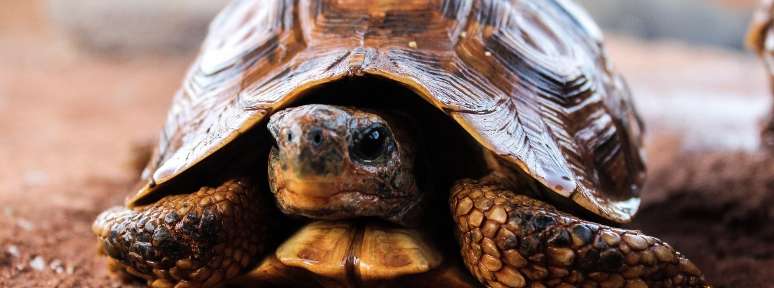
The problem(s)
Notes:
Perception of IT on campus is:
a bunch of nerds in a garage pecking away at computers
a department with the goal of making it harder to do work
not helpful and slow to respond
Exponential growth, while it was needed, has not coincided with implementation of more formal processes
Staff need professional development but not sure what kind

Slide 3
Where I Started
Notes:
How did the academy impact how I thought about / did this project
At first I was focused on identifying training needs and creating a plan for a retreat for User Services Staff. It was something I new I needed to do for this summer, wasn’t sure where to start, and was procrastinating on. However, this starting point left me feeling very overwhelmed and not sure what to focus on. Attending the academy and working with my mentor helped me be able to look more strategically and break down my initial goals into something that was achievable. So what was my project in the end?

Slide 4
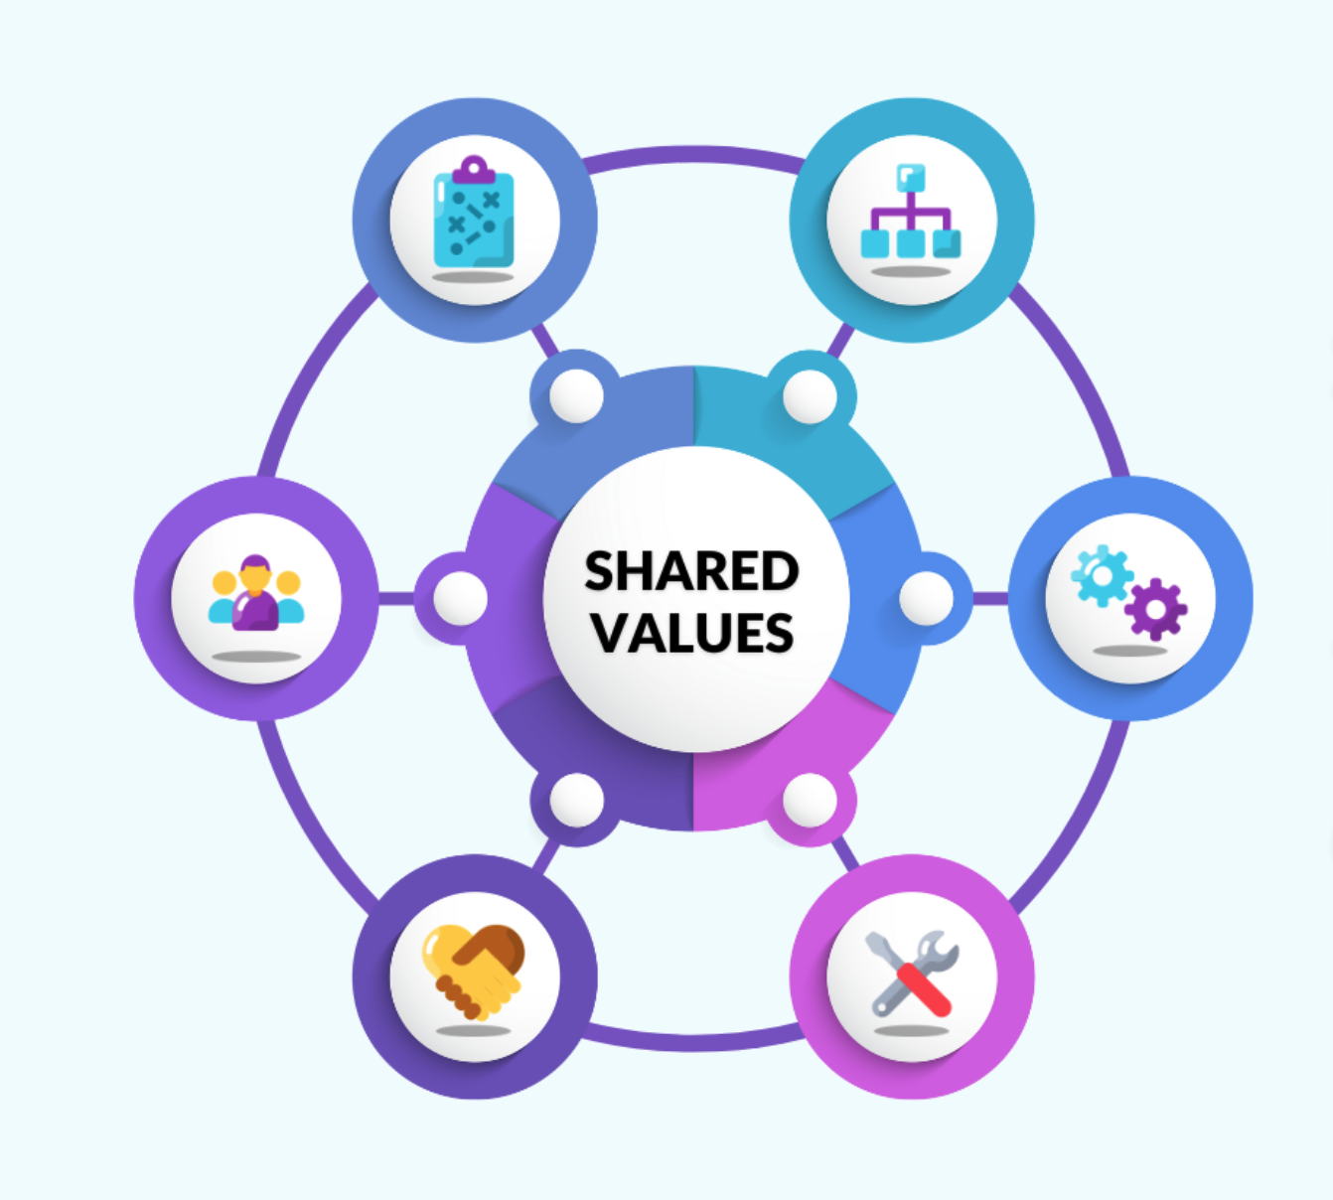
The Project
Notes:
A gap analysis! IT Services has been working to implement ITIL but still has a ways to go. Conducting a gap analysis would help us as a department identify the areas we needed to improve our ITIL implementation. While I love a swot analysis it just wasn’t the right fit for this project. After some research I landed on McKinsey’s 7 S’s which also aligned with some of what I learned, specifically that it can be helpful to identity the goal (thank you ITIL) and identify where you are (the analysis). The 7’s are: strategy, structure, systems, style, shared values, staff, skills.
The analysis was focused on service delivery, incident management, and change management. The audience for this phase was just the staff within IT services. If I had more time I would have included some faculty, staff, and students which I think would make a great phase 2.

Slide 5
Data Collection (Challenges & Successes)
Notes:
Initially created a survey (but it was awful)
Only 1 person filled it out. This clearly wasn’t working.
My backup plan was conversations. The biggest concern I had was that not everyone would feel like they could be honest with me in the room. However, these worked great in the end but the challenges for me were making sure I did not contribute but just seeded conversation and re-directed when constructive criticism turned to complaining.
The conversations were great, and I had a few examples of high performance teams. People let each other talk and no one person dominated the conversations; others encouraged their colleagues to provide input. I tried not to provide more than prompts or encouragement so as not to steer or stifle the conversation. I tried to convince my peers that we should have the conversation over tacos (it didn’t work).

Slide 6
Initial Results
Service Delivery
Need for greater cross-functional collaboration
Inconsistent customer perception vs. service intent
Process and policy enforcement gaps
ITSM tool functionality and usage gaps
Culture and vision alignment gaps
Staff and training gaps
Incident Management
Inconsistent and informal processes
Ticketing system and process inefficiencies
Communication gaps
Skills gaps and development needs
Reactive service orientation
Misaligned or inconsistent customer service culture
Staffing shortages and resource constraints
Change Management
Lack of standardization and formalization
Fragmented communication and collaboration
Staffing and skills gaps
Limited risk management and testing culture
Underutilized tools and technology
Notes:
These are the initial results from the analysis. I know this slide has a lot of text but the recurring themes are:
staffing issues, particularly needing more staff in areas where we have either no one or only one person responsible for a function.
Lack of depth in staffing was indicated as causing delays to ticket resolution, negatively impacting how we do change management, and impacting our ability to provide stable, good quality service
Inconsistent and informal processes also emerged in all three categories
This was largely ascribed to the team being approximately 5 people olyn a few years ago. The process for most things was to walk down the hall, talk to someone, and then take action. As the department has grown that process doesn’t work quite as well as it used to.
Communication gaps
Also present in all three categories and encompassing not just communication between various areas in IT but also between IT and our campus community.

Slide 7
Final Thoughts & Reflections
Notes:
The results from this analysis are not unexpected. I am looking forward to how we work together and use these results as a team to make improvements. I am excited to see where we are as a department in a year. And finally, I wanted to close by reflecting on my CIO academy experience. I learned many things, not just while working on this project, but from all of you. The conversations I’ve had and been apart of, especially during some of the in person events have taught me a great deal. I appreciate everything I’ve learned from all you and am excited to see what the future holds for all us.

