Slide 1
BRIDGING THE GAPS WITH iPaaS
Hasan Awwad
Technical Solution Specialist
SICAS Center

Slide 2
AGENDA
What is iPaaS?
The Plan
The Gaps
Building the Bridges
The Challenges
Closing Thoughts

Slide 3
WHAT IS iPaaS?
A bridge between technologies
Flows: iPaaS-flavored programs
Focusing on TDX iPaaS in particular
Small SICAS team
Notes:
Acronym
Sources of data, applications, and all other sorts of tech connected together
Director, PM, me, func user “Terry”

Slide 4
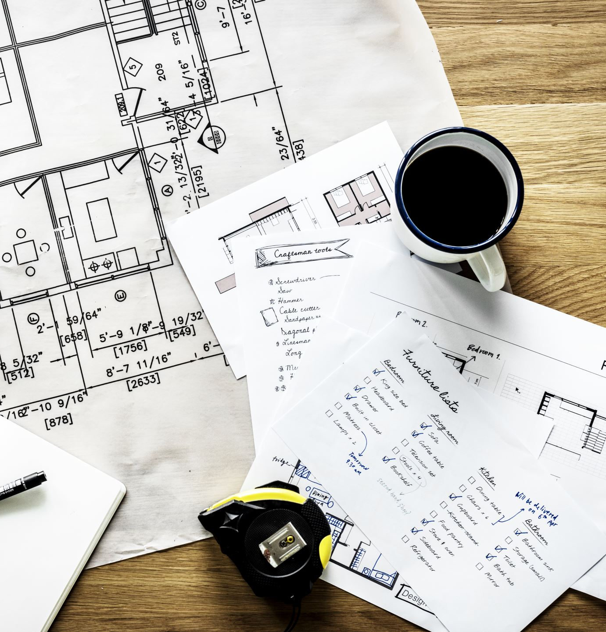
The Plan
Phase One: Implementation and Restored Functionality
Phase Two: Improved Efficiency
Phase Three: “The Great Unknown”
Timeline for Phase One: Completion by late September/October 2025
Notes:
Moved helpdesks from ServiceNow to TDX. Lost some functionality along the way, some things didn’t feel right in the ticketing application
Phase 2: utilize ipaas automation/connectivity for 35 projects/problems we brainstormed
Phase 3: we don’t know what we don’t know. Solve problems we didn’t even know about, or didn’t have back in P1/2
Emboldened because scope

Slide 5
The Gaps
Tickets not moving to an assigned state
Oneonta tickets reflecting individual departments
Wish to display CSS (Campus Support as a Service) information
No shared service desk instance with ITEC
Why do these matter?
Notes:
Important to whom? The stakeholders!
Clients:
Related to #4, convoluted process to bounce between two different tickets. Ticket in SICAS instance might not reflect work done in ITEC instance.
Employees:
Manually changing the state on every single ticket. Manually adjusting department on Oneonta tickets. Manually creating ITEC tickets. So much manual tedium, caught in the minutia. Could be doing something else
Leadership: Always a stakeholder on every project. Responsible for the clients AND the employees having negative experiences. Culpable for improving the situation for everyone.

Slide 6
BUILDING THE BRIDGES
Oneonta flow and ticket status flow both created unilaterally (hmm… whoops?)
CSS information flow used as an opportunity to “de-silo”
ITEC flow handled contractually by TDX, but still a learning opportunity
Notes:
Did first two by myself. Simple reason: there was a task, I knew I could solve it, so I solved it. Very little updates to PM, only involved Terry when I either couldn’t test or had no time to test.
Didn’t repeat the mistake. Weekly meeting for us to either get feedback or provide updates. Utilized terry more in the decision process (posting info to ticket or posting in form)
Recognized this as an opportunity to learn, got myself and Terry in with the TDX team to be present for the building. Leveraged Terry’s administrative expertise.

Slide 7
The Challenges
Challenge #1: CSS flow pivot
Initially posted information to a ticket
Created, tested, demoed, and 95% finished
New version to use entirely different modality
Challenge #2: Motivating a Coworker
Small directive, passed onto functional user
3 weeks, no movement
“He must be lazy.
He must not care.
He must not respect me.”
Notes:
Wasn’t seeing big picture. Stuck in worker bee mindset of “receive task, do task”.
Dance Floor To Balcony: Scheduled conversation with supervisor to see bigger picture. The idea is to have a one-stop shop—a central hub for the campus user to visit and see all their relevant information, and a form is
“People procrastinate what they’re afraid to do.”

Slide 8
Closing Thoughts
What I did wrong:
“Worker bee” mindset siloed myself and unintentionally my team
Took away growth opportunities from a coworker and didn’t approach the situation correctly
What I did right:
Identified the breakdowns in communication, worked to fix them
Enabled my coworker to grow once I realized the correct path forward
Notes:
Growth opportunities stemming back to the first two solutions

Slide 9
Closing Thoughts (CONT.)
Leadership is measured by the relationships you’ve built and the trust you’ve maintained.
Notes:
Dr. Scott V said “it’s about the people. If you don’t know what to do with your day, go bolster a relationship.” I’ve strengthened a relationship. I’ve started to establish trust—not just that I’ll get the job done, but the trust that I am not just in it for myself. I aspire to be a leader where those who work with me, and those who someday work for me, know that I am there for them. In spirit of it being about the people, extend gratitude to group members.

