Slide 1


^{Problem Solving with RACI}
Using Responsibilities Matrices to Bridge the Gap
^{Fion MacCrea}
^{2025 CIO Leadership Academy}
^{Applied Learning Project}
Notes:
Hello everyone, I’m Fion MacCrea with SUNY ITEC and my applied learning project discusses how RACI Responsibilities Matrices help us handle situations of shared responsibility.
RACI stands for Responsible, Accountable, Consulted, and Informed – it’s a tool originally developed by Project Management professionals.

Slide 2
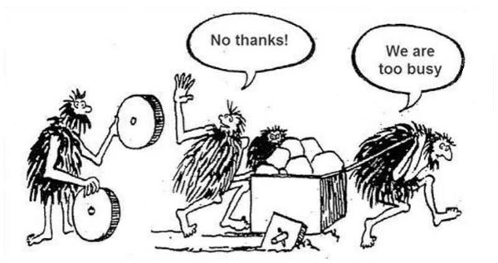

Notes:
But you don’t need to be a project manager to appreciate RACI charts…
We’ve all been there – jump in and get it done vs taking a few minutes to strategize!
I know my default is the former and I will often consciously do it the quick way even if it’s harder and yields inferior results!
I like this cartoon, because we often struggle to prioritize small investments that can pay big dividends.
Sometimes the best answer to a problem is the simplest.
We all want to be on the same page!!
I’d like to talk about how using RACI as a low-tech tool for technologists can yield serious efficiencies and alleviate frustration.

Slide 3


A Familiar Tale
“The network is down, and I can’t get a straight answer from any one of the SIX organizations involved!”
Notes:
The number of parties involved in supporting any given IT function continues to grow rapidly.
More vendors = more stakeholders = more complexity
Often there is no single person, procedure, or entity whose role it is to manage these multi-faceted relationships.
IT organizations can benefit greatly from the relatively inexpensive application of RACI to deliver efficient and effective solutions
At one campus I help support, we once dealt with a campus-wide network outage that lasted far longer than it should have due primarily to the lack of a unified troubleshooting effort with clearly defined duties among ITEC, Campus IT, and several outside support orgs. I’ll talk in a moment about how having a RACI chart could have made this event WAY less stressful, and probably much shorter!

Slide 4
RACI to the rescue
RACI – Responsible, Accountable, Consulted, Informed
Goals
Bridge the gap
Manage expectations
Outcomes
Resolve overlapping and conflicting responsibilities
Foster greater collaboration
Show IT as a leader
Notes:
There may be others, but two goals I’ll note are
Bridging the gap – communicating key details between geek and non-geek
Aligning and managing expectations – no one likes surprises from IT.
Ultimately, we want all the people involved in the project to know the WHAT, the WHO, and the HOW
Outcomes include derivations of clarity, collaboration, and leadership - all of which are good for any project.

Slide 5
Simple Strategy
Identify and Scope the project
Break down the work (rows)
Assign roles (columns)
Define duties (cells)
Notes:
How does RACI work?
Define the desired scope of work – Identify the problem, project, or process at hand.
In the chart we’re building, the Rows are the WHAT: Outline discrete functions/tasks – Break down the work into specific tasks or groups of tasks.
Columns in the chart are the WHO: Clearly designate who may be involved in each function/task.
Cells in the chart are HOW people’s duties are defined: Responsible, Accountable, Consulted, and Informed

Slide 6
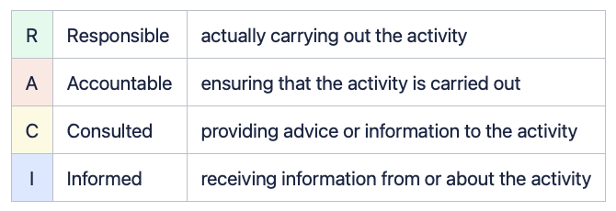
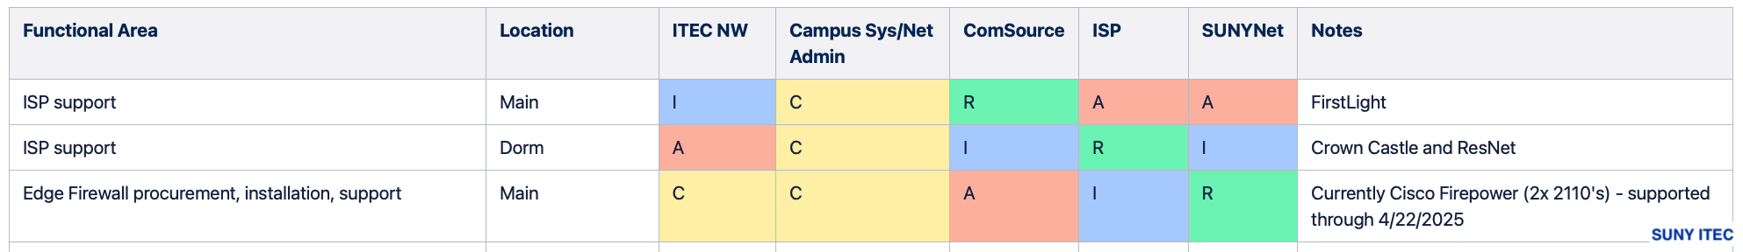
Technology & Tools
Notes:
The tech for RACI is simple, cheap, and easy.
Can be a whiteboard, an Excel sheet, or a wiki. Or a napkin and crayons!
Keep it simple and maintainable!
The example shown here includes a color-coded legend and speaks to the network outage I noted a moment ago.
The WHO here are ITEC Network Admins, Campus System Admins, and multiple external support orgs… Oh, and the CIO breathing down everyone’s necks!
The WHAT here is Network connection support from the Internet Service Provider – downstream to the campus
The HOW is what each cell defines at that person-action combination’s role.
In that tense production-down scenario, the CIO and the campus IT admins could have begun triage with this dialogue:
Q: “Is the Network down across the entire campus, or in a particular area?”
A: “Helpdesk says it appears that it’s across the whole main campus!”
Q: “Ok, who’s our ISP for the main campus internet connection?”
A: “RACI chart says it’s FirstLight, but it’s brokered through ComSource, so they’re RESPONSIBLE, let’s call them first.”
<Call to ComSource support – your circuit is up… must be something downstream.>
Q: “Ok, what about the edge firewall - and don’t we pay ComSource to manage that thing too?”
A: “Nope, that’s our Cisco Firepower and according to the RACI, SUNYNet handles that. I’ll put a ticket in with them.”
And BTW, did the support get renewed on those devices?!
Since ComSource is Accountable for the firewall operations too, I’ll loop them in on call with SUNYNet.
In this example the RACI helped in several ways:
It put the situation in terms the CIO could understand
It framed the troubleshooting workflow to minimize time consuming missteps, and finger pointing.
AND… I could tell you how it went WITHOUT a RACI, but I’d need at least another hour…!

Slide 7
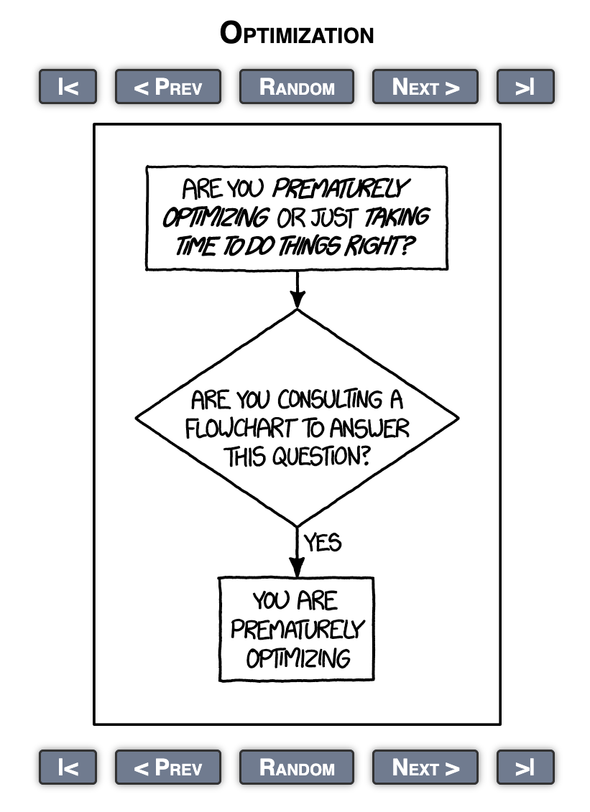
To RACI or not to RACI…
Notes:
It shouldn’t be too hard to decide if a RACI is worth the effort…
It’s not as weighty as your strategic plan.
But it’s more work than just jumping in and “seeing what happens”
It’s an exercise that’s almost always a force multiplier.
Rule of thumb – if there are 4 or more people or groups involved, it’s probably worth a RACI!

Slide 8
Other applications?
Intra-department and Inter-department use cases
External applications
Integrate with other tools
Notes:
RACI’s need not be one and done documents.
They’re dynamic, evolving, and connected to other processes and procedures.
RACI is a tool for any organization
Examples:
Between IT and business and functional offices
Externally between Vendors, SUNY-wide programs, campus auxiliary services, etc
And finally - RACI can feed and be fed by other tools and processes:
We leverage this tool and associated processes to bolster IT Service Management capabilities.
Agile PMO, Six Sigma, ITIL/ITSM etc

Slide 9

Final Thoughts and Reflections
Notes:
The more I learn about leadership, the more I learn about People! … The more I can appreciate a tool like RACI.
I like technology as much as any IT nerd, but especially in light of what we’ve talked so much about throughout the Leadership Academy – the person to person interface is often under appreciated.
RACI’ bridge the geek – non-geek gap and align expectations.
And If you can do that, the tech will be the easy part!
So, Can you think of ways you’d use a RACI to make life better?
-My wife says we could use it all the time!

