Slide 1
IPocalypse Averted
Alan Lawton

Slide 2
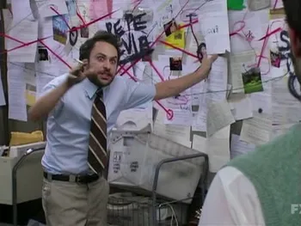
Explanation of the Project
Missing DNS Records
Old Bind Servers with Siloed Permissions
Scattered Documentation
Missing Documentation
DDI (DNS, DHCP, IP Address Management)

Slide 3
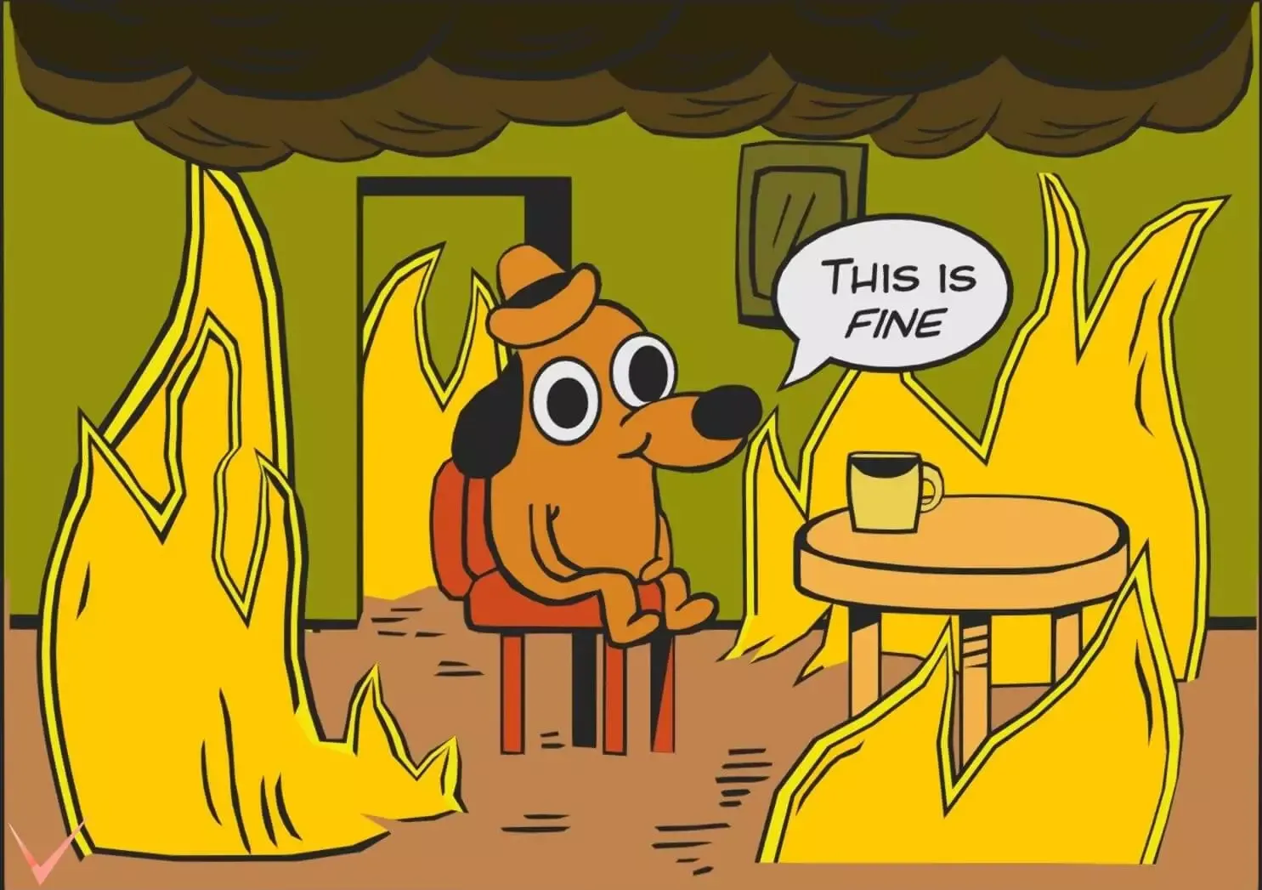

Slide 4
If at first you don't succeed, tear it down and start again
Alan Lawton

Slide 5
How did we get here?
40 Years of Differing Design Philosophies
Servers allowed to reach end of life
Infrastructure at end of life
Firewalls with overly permissive policies
Rapid Organizational Growth
Including All New Systems Engineers

Slide 6
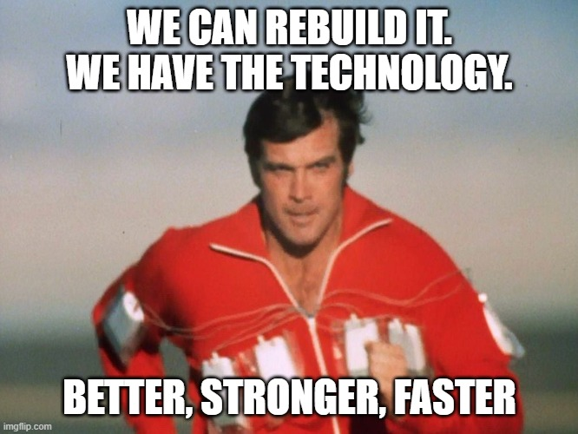
Where are we going?
Replace VM Environment
Replace All Servers
DDI Implementation
Greenfield LAN
Implement New Firewall Policies

Slide 7
Narrowing the scope.
Kickoff meeting with all stakeholders
Identify Network Requirements
Future Proof
Define a timetable
Network was prerequisite for other changes
Firewall Policies focused on Zero Trust

Slide 8
Making Molehills out of Mountains.
How do firewalls work again?
Explain Stateful Firewalls and how policies are created
Who is responsible for this information
Routing table, that’s like an ACL right?
Planned for Management and Production Interfaces on all servers
Explained Routing tables

Slide 9
Thoughts and Reflections
Crucial Conversations
Separate fact from story
I don’t have to have all the answers, even when I have all the answers
Shifting from the Doer to the Leader
Shout outs to Simeon and my fellow Simeonites
I get by with a little help from my friends
Thank You!
www.nysernet.org
alawton@nysernet.org

