Slide 1
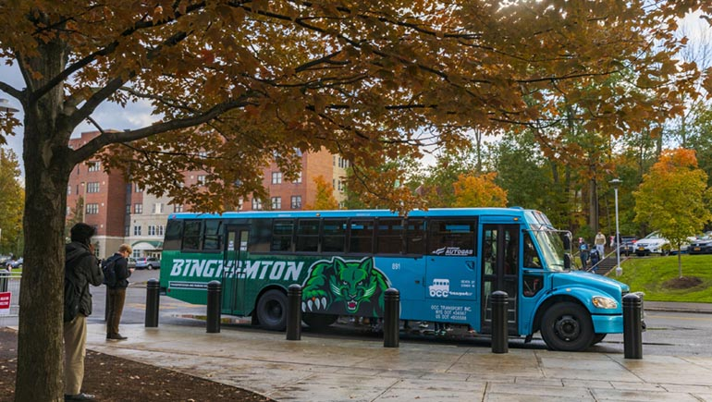
Strategic Shifts: The Case for Reorganizing Campus Telecom
Past Profits and Present Priorities
Notes:
Golden Era of Telecom
* Toll Charge Income
* Directory Ad sales
Blue Bus Story
* $350,000
Still Used to Subsidize
* Staff and Services and Equipment (Panics, Billing, Vans)
* Push rates higher. That with technology has services decreasing

Slide 2
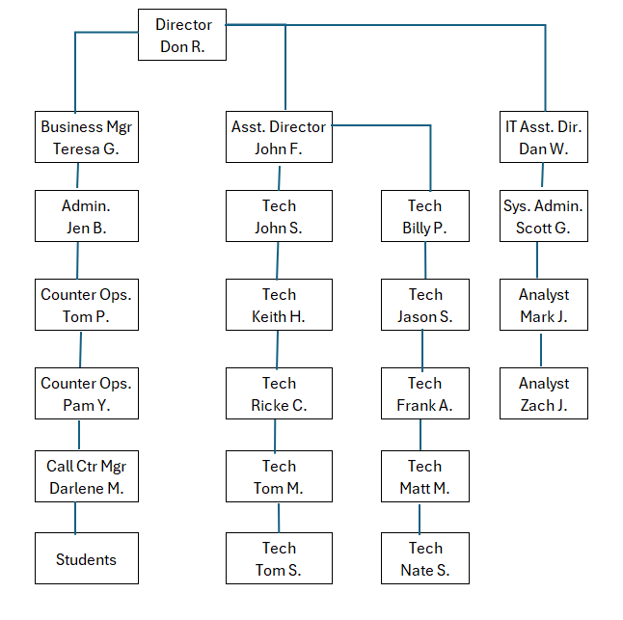
Ghost of Telecom Past
Budget
$3.5 - $4 Million
Staff
7 Admin
4 IT Staff
10 Techs
20 Students
Notes:
Budget - Toll Charges, Audio Bridges, Directory Advertisements.
Org Chart – 7 Admins, 4 IT Staff, 9 Techs, 20+ Students

Slide 3
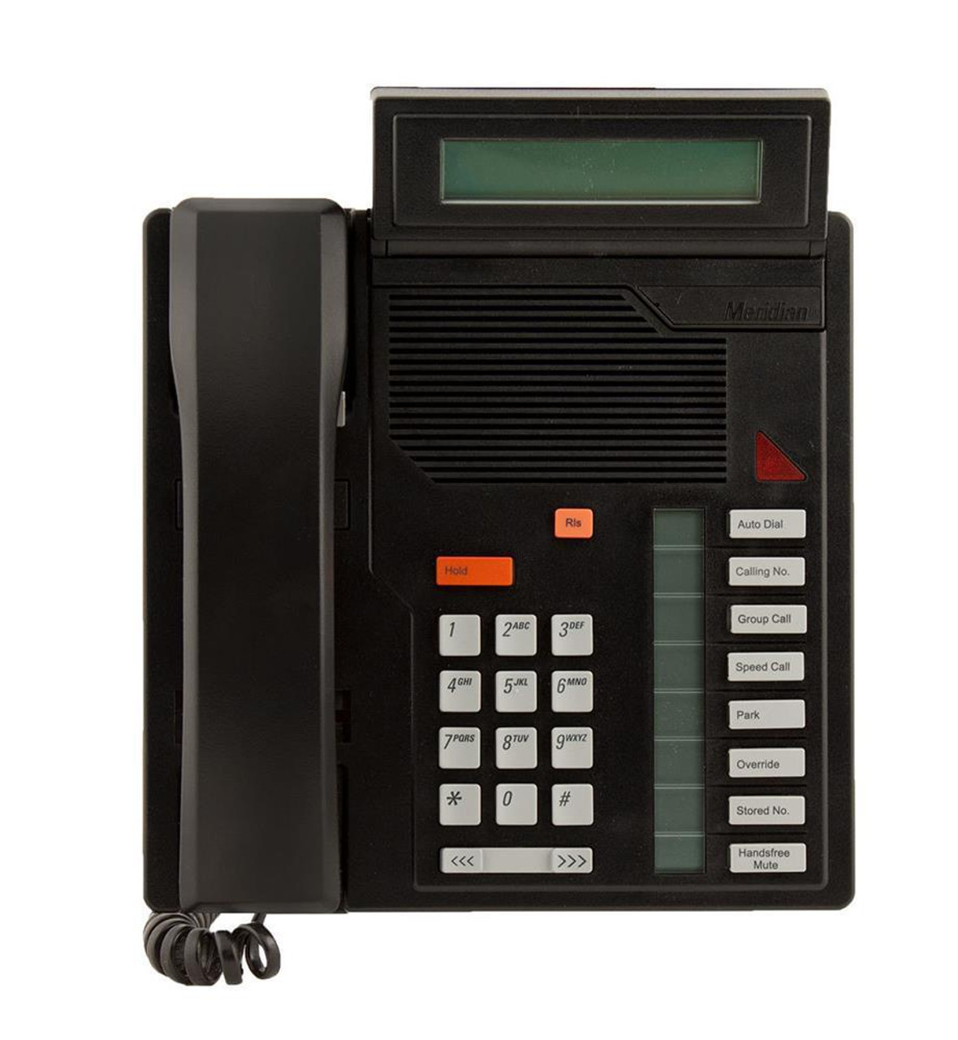
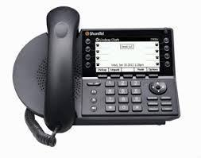
2005 2015 2025
Notes:
2005 – Telecom was Nortel Analog and Digital Phone sets
2015 – Shortel/Mitel VoIP
202 – Softphones, Cell Phones, UCASS
Changing Landscape – MACDs used to take two guys an hour or so to tone out pathways. Now an employee moves their own equipment.
Change in Tech Skills – From 66 blocks to Patch panels. TN/DN to VLAN/DHCP Options
I had 4 meetings last week. All were either via Zoom or on Teams. How many used to be a conference call?
This Academy, up til today, was all on Zoom.

Slide 4
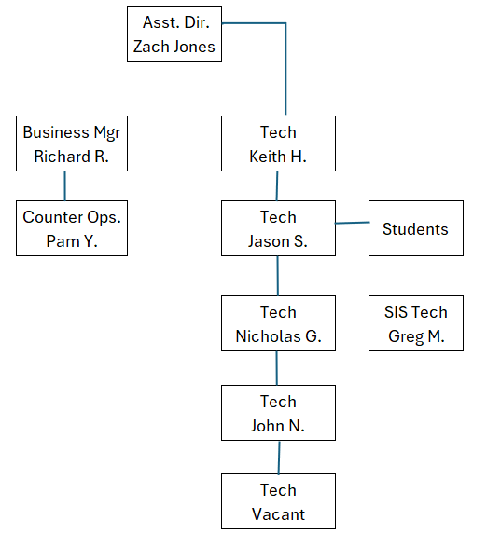
Telecom Present
Budget
$1.3 Million
Staff
2 Admin
4 Techs
2 Students
Notes:
2024 – Budget 1.3 Million
Telecom – 5 staff members
Subsidizing – 2 office staff members, 1 installer, and 1 network tech
Subsidizing – Service Mgmt System, equipment and licensing
CSEA office staff can handle a lot of the tickets for MACD. Setup the AD Sync in the system and with pre-existing equipment or softphone it is all done.
Tech is now responsible for ACD, more detailed call routing options, and in-depth troubleshooting.
We can not handle all of our own installs and outsource all OSP work and, at times, construction projects.
Removing services from Dorms will, at some point, result in the loss of large DIFR allocation.

Slide 5
What I Purpose
Notes:
Hoping this Academy pays off.
Creating a presentation to address your own position is probably not the most personally and financially feasible idea I would suggest.
No other SUNY has an AD of telecom. It is a joint role under networking.

Slide 6
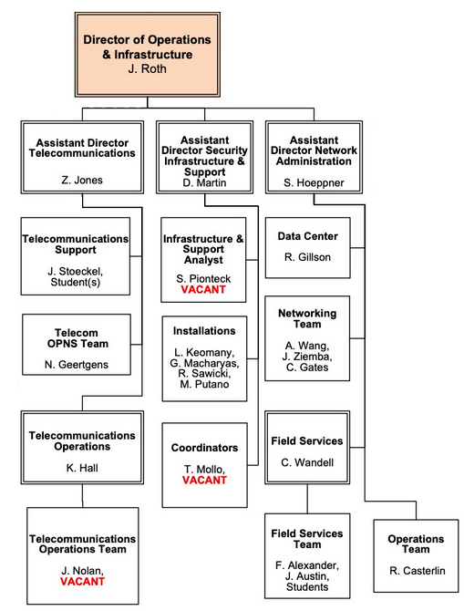
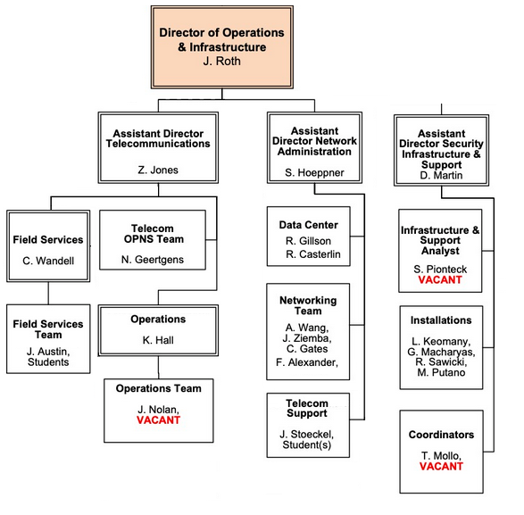
Telecom Future
Assistant Director
IT Infrastructure
In

Slide 7
Plan & Benefits
Benefits
Project Mgmt
Work Alignment
Budget Allocations
Process
ADKAR
Communications
Notes:
Hoping this Academy pays off.
Creating a presentation to address your own position is probably not the most personally and financially feasible idea I would suggest.
No other SUNY has an AD of telecom. It is a joint role under networking.

Slide 8
THANK YOU!
Question, Comments, or Observations
Notes:
Hoping this Academy pays off.
Creating a presentation to address your own position is probably not the most personally and financially feasible idea I would suggest.
No other SUNY has an AD of telecom. It is a joint role under networking.

