Slide 1


CIO Leadership Academy Applied Learning Project
Notes:
INTRODUCTION- Background

Slide 2



A Resource for AI @ CSI
Patricia Kahn
College of Staten Island

Slide 3
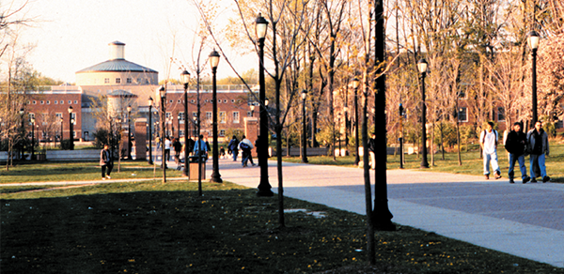
Who is the College of Staten Island (CSI)?
Four year senior college – Call us CSI
City University of New York (CUNY)
204 acres
Approximately 11,000 students;
2000 faculty & staff
Nationally ranked, offering two and four year degrees, graduate level, doctorate, and continuing education
Rural setting close to Manhattan; mostly commuter campus
Majority of classes face-to-face

Slide 4

AI is being used across the College in a variety of ways by all constituents:
faculty, staff, and students
Create a website to be used as a resource for best practices, challenges and opportunities
AI @ CSI
Notes:
/ Succinctly state: What are you trying to do? Why? And what are the expected outcomes?

Slide 5

Why the Project?
General negative feelings about AI
Community already using – chatter
Interest in topic – CUNY IT Conference
Provide a central resource; teaching and learning; administration
Use AI appropriately
Notes:
/ Succinctly state: What are you trying to do? Why? And what are the expected outcomes?

Slide 6

High Performing Team
Task Force involved in AI:
Faculty, IT staff, Librarians,
Instructional Designers; Accessibility
Teams site
Frequent meetings for feedback
Website template
Survey

Slide 7
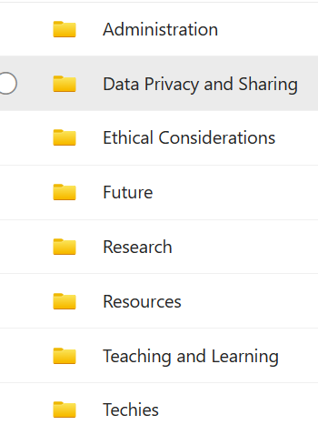
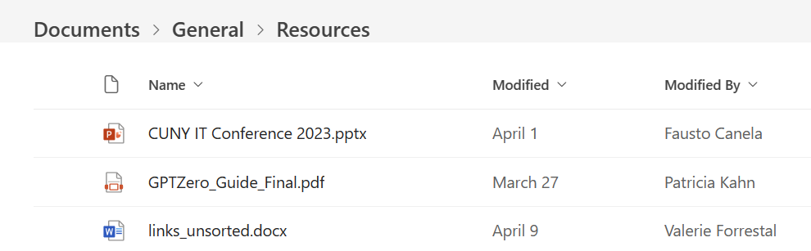
Teams

Slide 8

Challenges/Obstacles
Communication about website
  Stopped using Email – converted to Teams
  Created folders for committee to upload their content – more organized
Explore who is already using AI at the College
  Survey
    Created using ChatGPT
    Shared with committee for feedback
Too much content
  Consolidated – Teams site

Slide 9
Communication Plan
Due Date | Responsible | Task | Audience | Status
February 26 | Patty Kahn | Kick off meeting | Task Force | Complete
March 18 | Patty Kahn | Create Teams site; resource folder | Task Force | Complete
April 1 | Patty Kahn | Create website shell | IT/Task Force | Complete
April 26 | Task Force | Upload content into Teams; Finalize survey | Community | Complete
May 3 | Task Force | Survey | Community | Complete
June-August | Task Force | Finish website | Community
September 1 | Task Force | Create communication | Community
September 30 | Task Force | Launch | Community

Slide 10
Survey: Understanding AI Usage in Higher Education
Familiarity with AI
Utilization
  Administration
  Research
  Teaching and learning, etc.
Specific applications
How long using AI
Benefits and challenges
Future outlook
Anecdotal comments
Let’s see the results – 34 responses

Slide 11
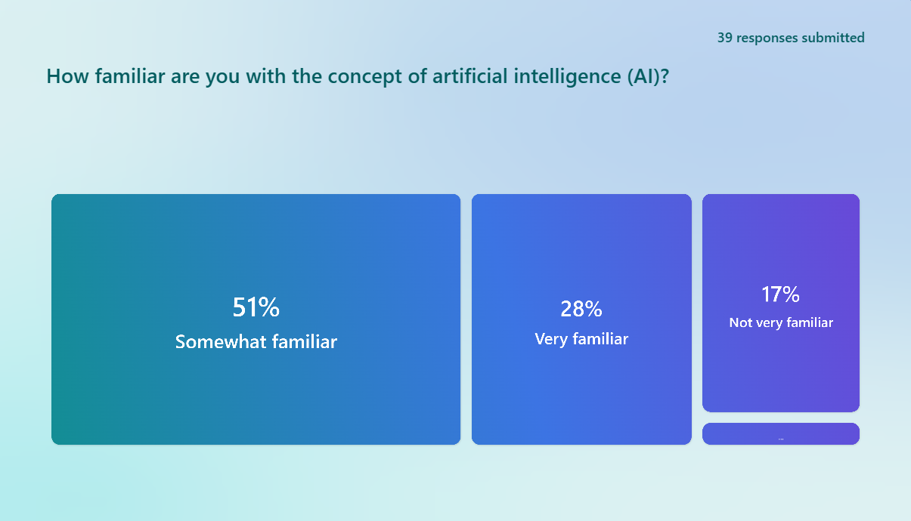
Survey: Understanding AI Usage in Higher Education
Administrator 44%; Faculty 53%; Students 2%
Familiarity with concept of AI

Slide 12
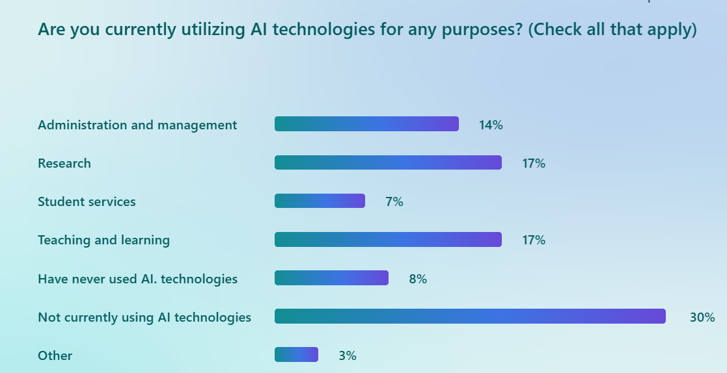
Survey: Understanding AI Usage in Higher Education
Purpose of Using AI

Slide 13
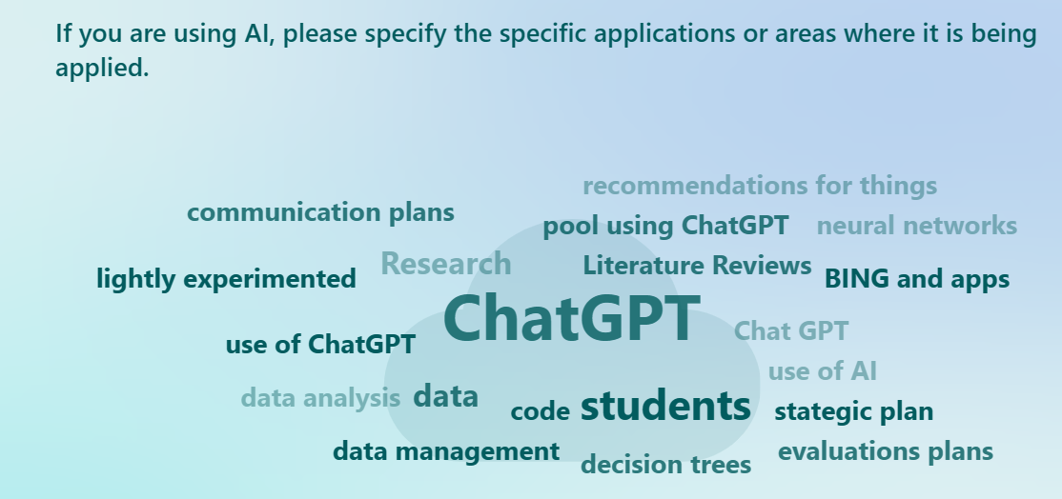
Survey: Understanding AI Usage in Higher Education
Areas where AI is being applied

Slide 14

Survey: Understanding AI Usage in Higher Education
Benefit Ranking
Enhancing Teaching and Learning
Improving Administrative Efficiency
Advancing Research
Personalized Student Support

Slide 15
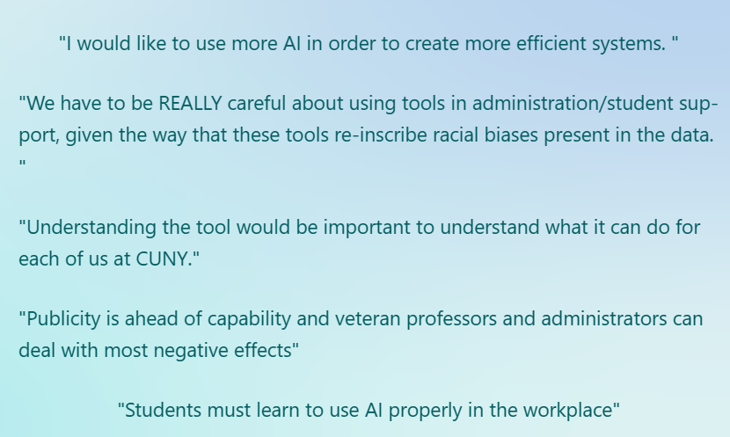
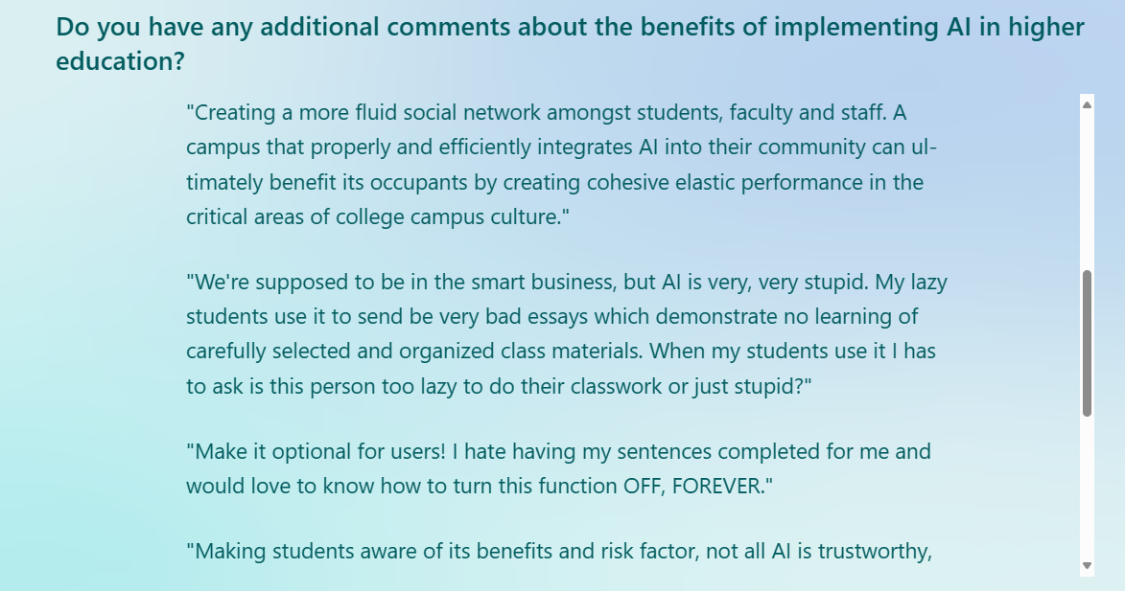
Survey: Understanding AI Usage in Higher Education
Comments - Benefits

Slide 16
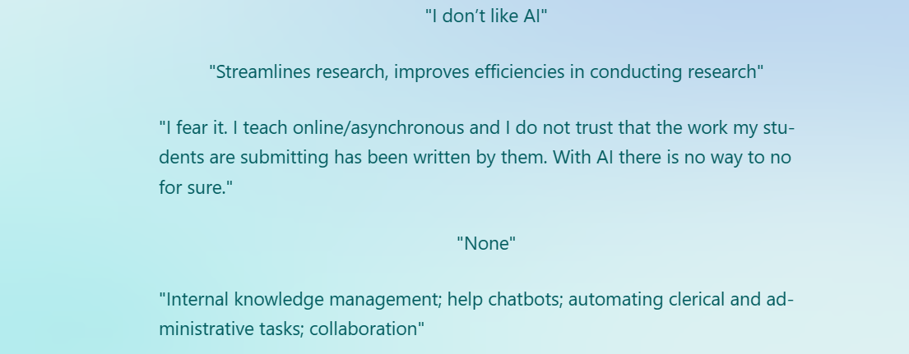
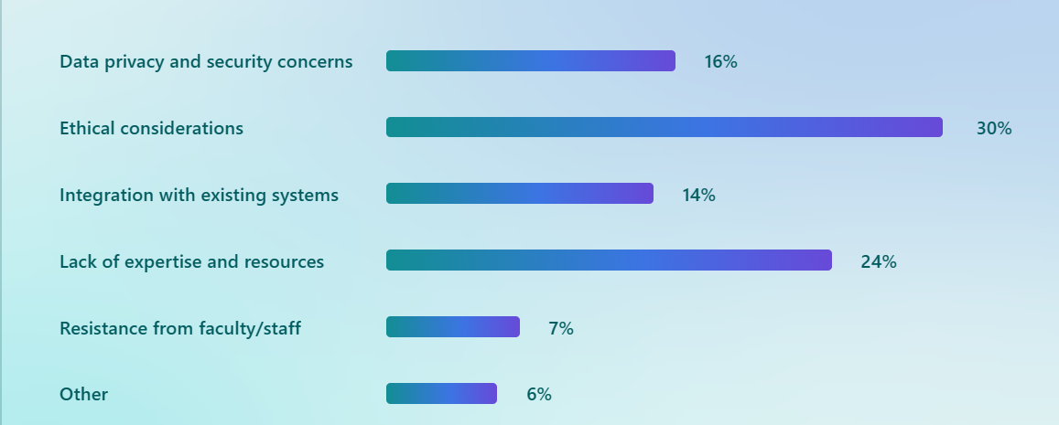
Survey: Understanding AI Usage in Higher Education
More Comments….

Slide 17
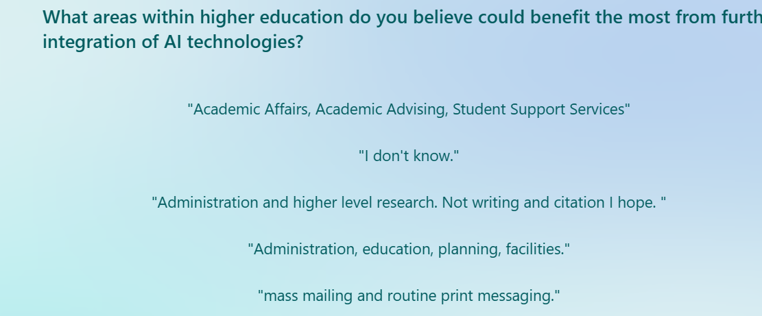
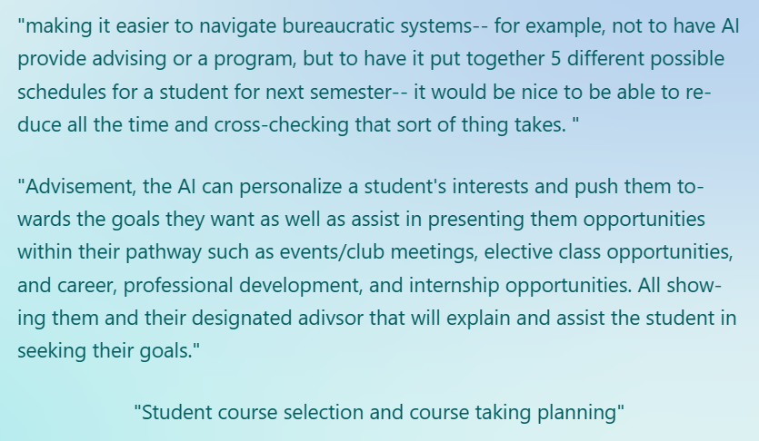
Survey: Understanding AI Usage in Higher Education
Areas Benefit from AI

Slide 18
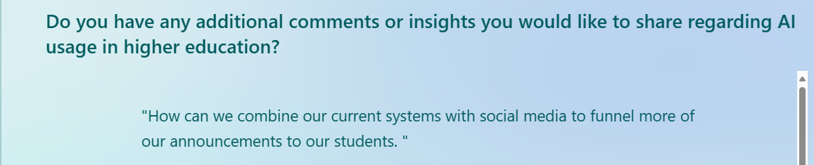

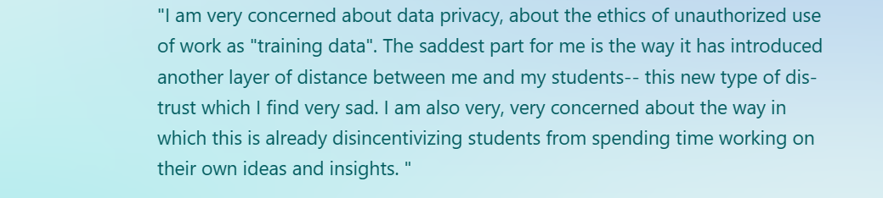
Survey: Understanding AI Usage in Higher Education
Additional Insights

Slide 19
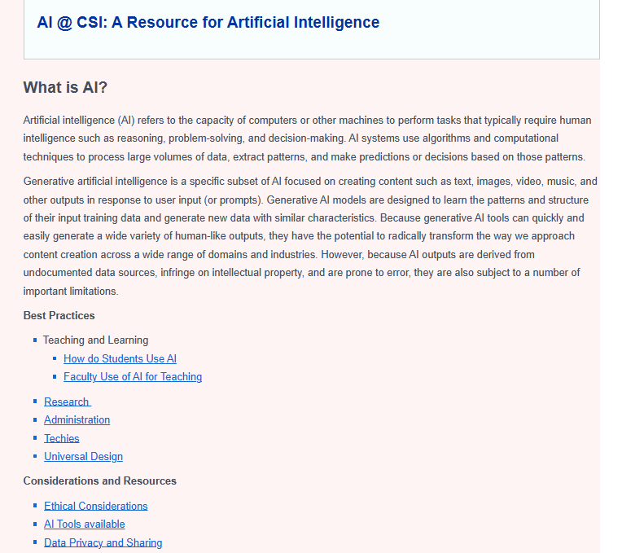
Website:
First Iteration

Slide 20
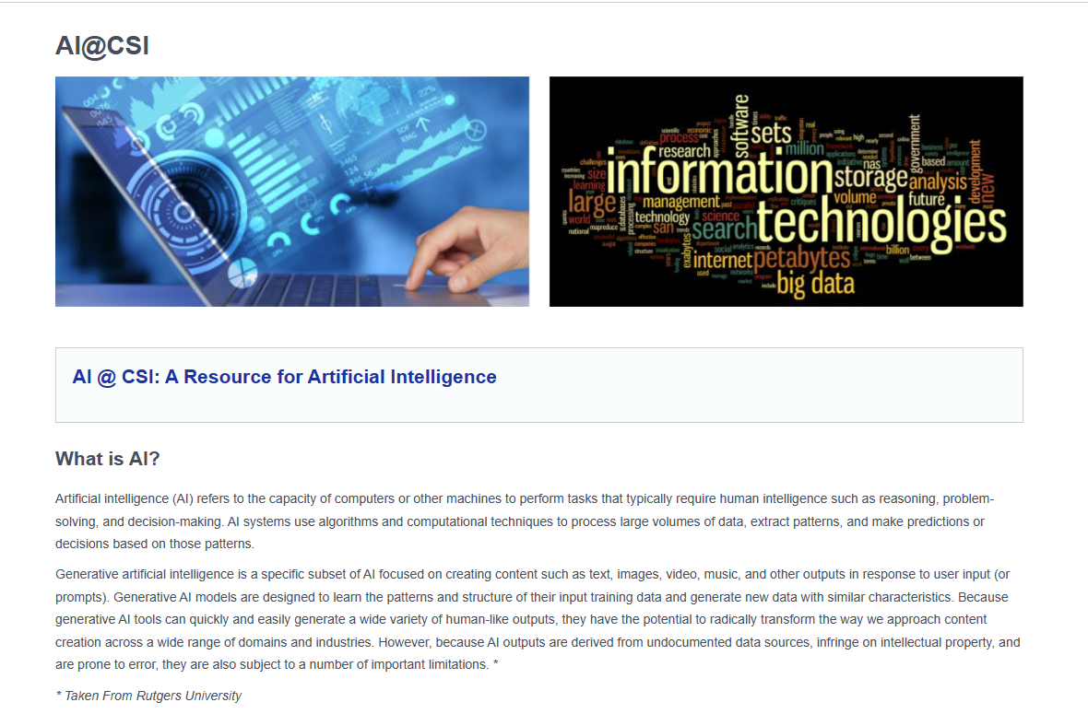
Website Improvements

Slide 21
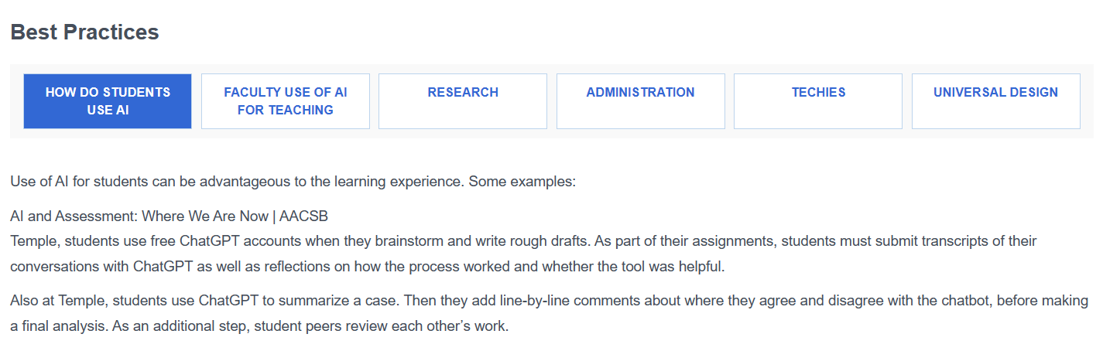
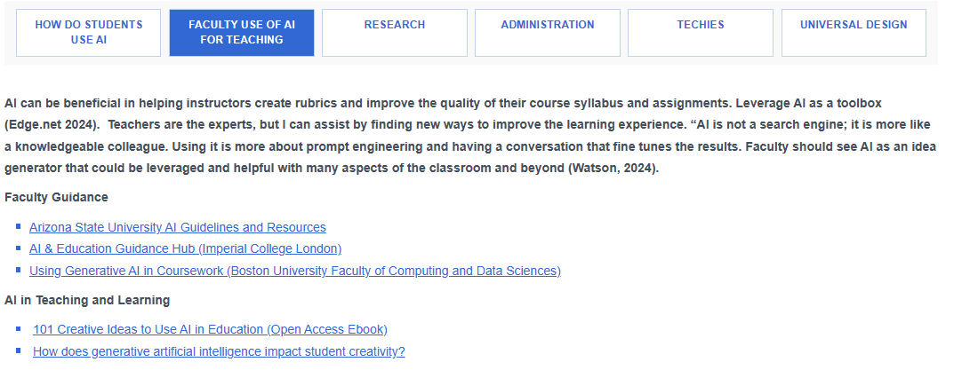
Website Improvements

Slide 22
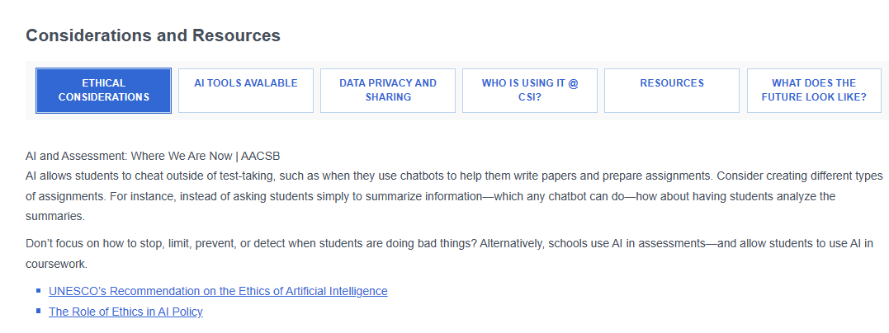
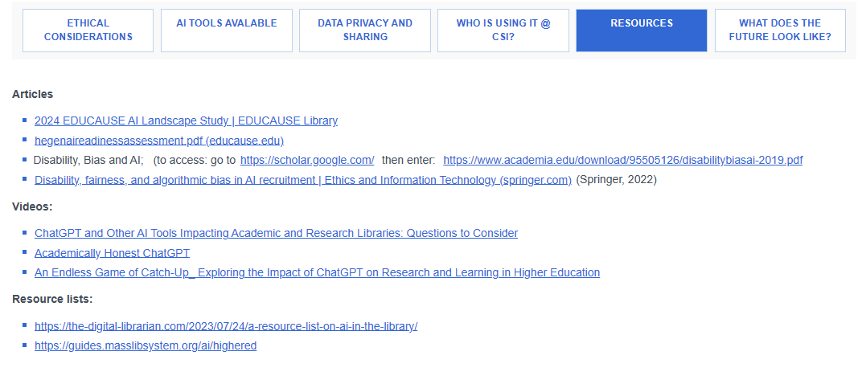
Website Improvements

Slide 23

Final Thoughts and Reflections
Interest is there – but cautious
Important to have faculty feedback and buy in
Future is scary
Community involvement
Everchanging
Town Halls; Training
This Photo by Unknown Author is licensed under CC BY-SA

Slide 24

Care to Share?
What is the AI culture at your College?
Would an AI Resource be helpful?
What do you feel the future landscape looks like?
Is there anything CSI should consider as we build out our AI Resource?
This Photo by Unknown Author is licensed under CC BY-SA

