Slide 1
I DIDN’T Sign up for this!
A story of burnout and the use of AI to bring doctors back to the bedside.

Slide 2
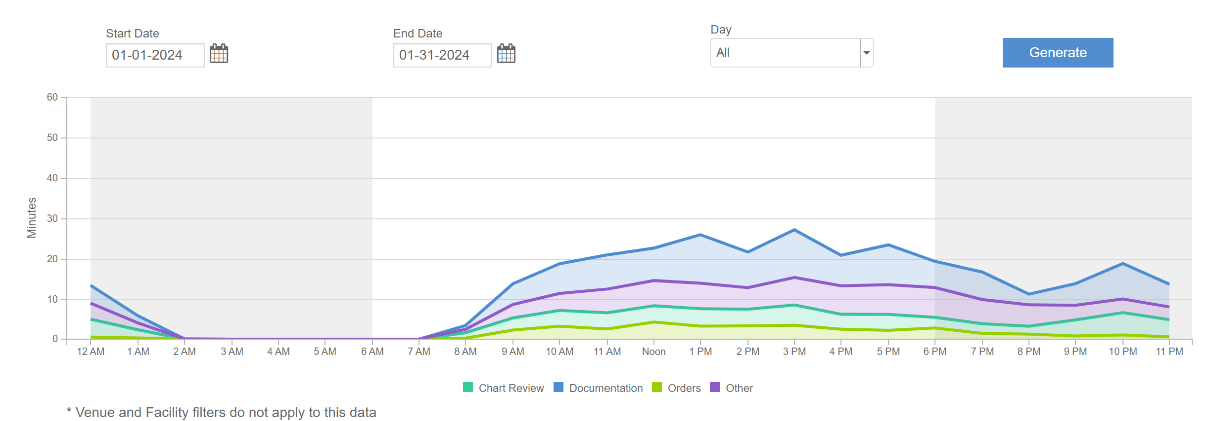
Meet VIVICA
58 years old family medicine doc
Married with 2 kids in high school.

Slide 3
History of Burnout
malaise
Fatigue
1974 first described
1981 Burnout measured
1980-90s HMOs push for throughput
2009 Meaningful Use adds documentation burden
2015 Mayo clinic report 54% have at least 1 symptom of burnout. Depression 40%, suicidal thoughts 6%
2018 moral injury identifies gap between care docs want to give vs what they can
2019 WHO recognizes burnout as a medical condition
2020 COVID 19 accelerates burnout
Frustration
Cynicism
Inefficacy
Notes:
BURNOUT: “malaise, fatigue, frustration, cynicism, and inefficacy”

Slide 4
Work is killing me
~ 300 - 400 physicians die by suicide annually
Suicide deaths are 250 - 400% higher among female physicians when compared to females in other professions
Male doctors have suicide rates as much as 40% higher than the general population

Slide 5
The Rise of EMRs
Early 19th century medical records beginning in Paris and berlin
1972 the Regenstreif Institute developed the first EMR in US
2009 Obama signs the American Recovery and Reinvestment Act AND HITECH Act
1990s EMRs where seen in academic centers to support claims and billing
2004 Bush Sr creates office of National Coordinator for HIT to ensure EMRs within 10 years
2011 Meaning Use Payments from the HITECH Act begin ~36 Billion

Slide 6
Why the Shift?
PAPER
Electronic Medical Records
Pros:
True simple narrative of provider thoughts
No data entry.
CONS:
Data retrieval difficult.
Storage of paper FOR YEARS is expensive.
Lack of easy data retrieval led to repeat testing.
Pros:
Data accessibility
Data transmissibility
Data mine ability for quality and billing.
CONS:
Someone has to enter the data
Lack of national standards for data between different EMRs transmissibility

Slide 7
From Healer to data entry clerk
International Classification of Diseases (ICD) started in the 19th century to help codify disease
ICD-10 coding system (2015) represented a significant milestone in healthcare documentation and billing practices.
ICD-10 includes 68,000 codes, allowing for a much more detailed representation of medical diagnoses and procedures.
ICD-10 brought increased specificity and complexity in healthcare documentation and billing.
While offering benefits in terms of enhanced data accuracy and clinical decision-making
ICD-10 has necessitated adjustments in physician documentation practices to meet coding requirements and ensure compliance with billing regulations.
ITS COMPLEX

Slide 8
Docs spend 26.6% of their day documenting and 27.5% Talking with patients- The Burden
Past medical conditions
Medications
Allergies
Social history
Physical examinations
Vital signs
Assessments of patient conditions, including differential diagnoses and prognoses
Develop comprehensive treatment plans outlining medications, procedures, and follow-up care.
IT’S A LOT

Slide 9
How do we bring doctor back to the bedside?
Smart speakers (Alexa, Google) and voice recognition technology laid the groundwork for the adoption of ambient AI listening in healthcare.
AI advances in natural language processing (NLP) technology matured to leverage AI for real-time interpretation and analysis of spoken conversations.
Ambient AI listening passively listens to and interprets spoken interactions between patients and healthcare providers
The promise:
improve documentation accuracy
facilitate more natural interactions between patients and providers.

Slide 10
Introduction of SUKI & NUANCE DAX
2 years of contracting
Scoping
Integration with the EMR
Two Companies:
SUKI: Start up company willing to provide free trial and integration. Product $400/provider/month
DAX: Microsoft market leader with rigid contracting. No trial. Product $1600/provider/month

Slide 11
The SUKI Trial

Slide 12
Post trial Survey
Would you recommend the ambient scribe technology you tested to a friend or colleague?
How disappointed would you be if you no longer had access to ambient scribe technology
What was your primary means of documenting clinical encounters prior to utilizing ambient scribe technology
How has ambient scribe technology impacted the quality of your notes?
Are you satisfied with the documentation turnaround time provided by ambient scribe technology?
Has your use of ambient scribe technology impacted the overall quality of patient experience?
Would you pay for this technology out of your own salary?
Comments

Slide 13
Suki Survey SAYS!!
The GOOD
The Bad
8/12 would be disappointed if the app was turned off.
50% felt the technology made their notes worse. 50% felt note quality was at LEAST the same if not better
75% were happy with the turn around time of the note.
6/10 people felt they spent LESS time documenting.
7/12 people felt they spent LESS time interacting with the computer while in the exam room.
7/12 felt LESS cognitive burden of documentation
84% felt the overall quality of patient experience was the same or Better
The technology was UNABLE to show benefits in the following:
Better work/life balance.
Reduce burnout or fatigue.
Higher Job Satisfaction.
Less likely to leave the organization.
Ability to see more patients.
75% (9/12) would NOT pay for this technology with their own salary.

Slide 14
DAX Trial Results
“I cant live without this” – Vivica
Improvements in Note turn around time, decreased burnout symptoms.
Willingness to see more patients
Unfortunately this technology is cost prohibitive for general distribution

Slide 15
Next Steps: Cast a wider net
Reach out to more companies and do Sim center testing:
3m
Abridge
Ambience health
Augmedix
Nabla
Oracle

