Slide 1
Piloting a Key Decision Document
Prepared by Lisa Hupf
Director, Applications Development
Rochester Institute of Technology
May 9th, 2024

Slide 2
Rochester Institute of Technology (RIT)
Located in western New York
20,570 students enrolled at main campus; ~3600 students enrolled at international locations
Doctoral university; high research activity
Strong focus on engineering, computing, art and design

Slide 3
Pilot a decision template to review and recommend solutions for the RIT Data Hub Program
Goals and Outcomes
“The best decisions are made by those who are informed, not by those who are opinionated”
-Benjamin Franklin
Transparency
Trust and Collaboration
Impacts and Costs
Budget and Planning Considerations
Idea Generation
Well Informed Decisions
Consensus Building

Slide 4
Team Climate
“Culture eats strategy for breakfast.”
-Peter Drucker
Get Buy-in before starting
Decision Selection
One Strategic Decision
One Operational Decision
Analysis Teams
Self Select
Review Teams
Notes:
.

Slide 5
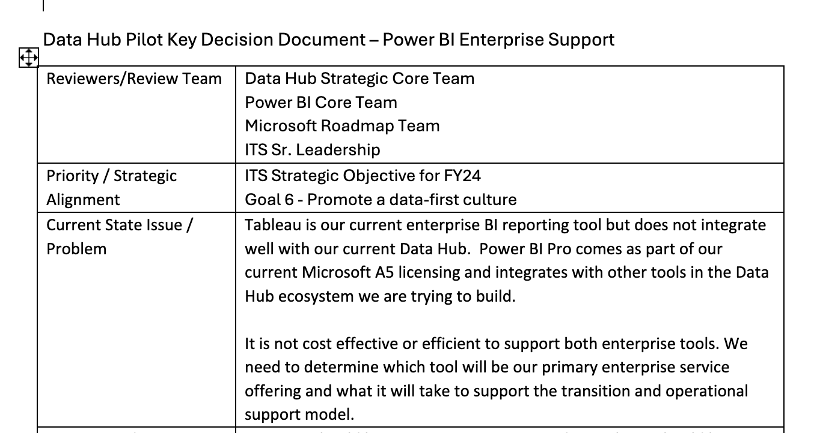
Sample From Template

Slide 6
Communication channels
“A team is not a group of people that work together. A team is a group of people that trust each other.”
- Simon Sinek

Slide 7
Conflicts / Challenges
“Don’t let yesterday use up too much of today.”
– Will Rogers
Form Fields
Operational decision already made prior to review
Bring everyone along with a shared understanding
Clarity in document storage
Time constraints
Manage Scope (Interest)

Slide 8
Learnings from the Class
“I never learned from a man who agreed with me.”
—Robert A. Heinlein
Engage People
Watch and Empower
Leading Change
Know yourself
Leadership 360
Fiscal Responsibility
Empathy
Notes:
.

Slide 9
“Good decisions come from experience. Experience comes from making bad decisions.”
-Mark Twain
What is next?
May/June Retrospective
1: Was the process useful to the program?
2: Should we continue to use it?
3: Should we modify the process and continue to use it?
4: Should we share the feedback with other teams?
Also… Some Early Feedback
Notes:
.

Slide 10
Questions?

Slide 11
Reviewers/Review Team
Priority / Strategic Alignment
Current State Issue / Problem
Recommendation
Benefit to RIT
Impact to user community
Consequences if no action taken
Data in scope (including data classification)
Action Plan and Estimated Dates
Estimated implementation cost and effort
Estimated operational cost and effort
Notes:
.

