Slide 1
Adopting TeamDynamix
A Lesson in Leadership
Lindsay LaBella
Genesee Community College

Slide 2

Time for Change

Slide 3
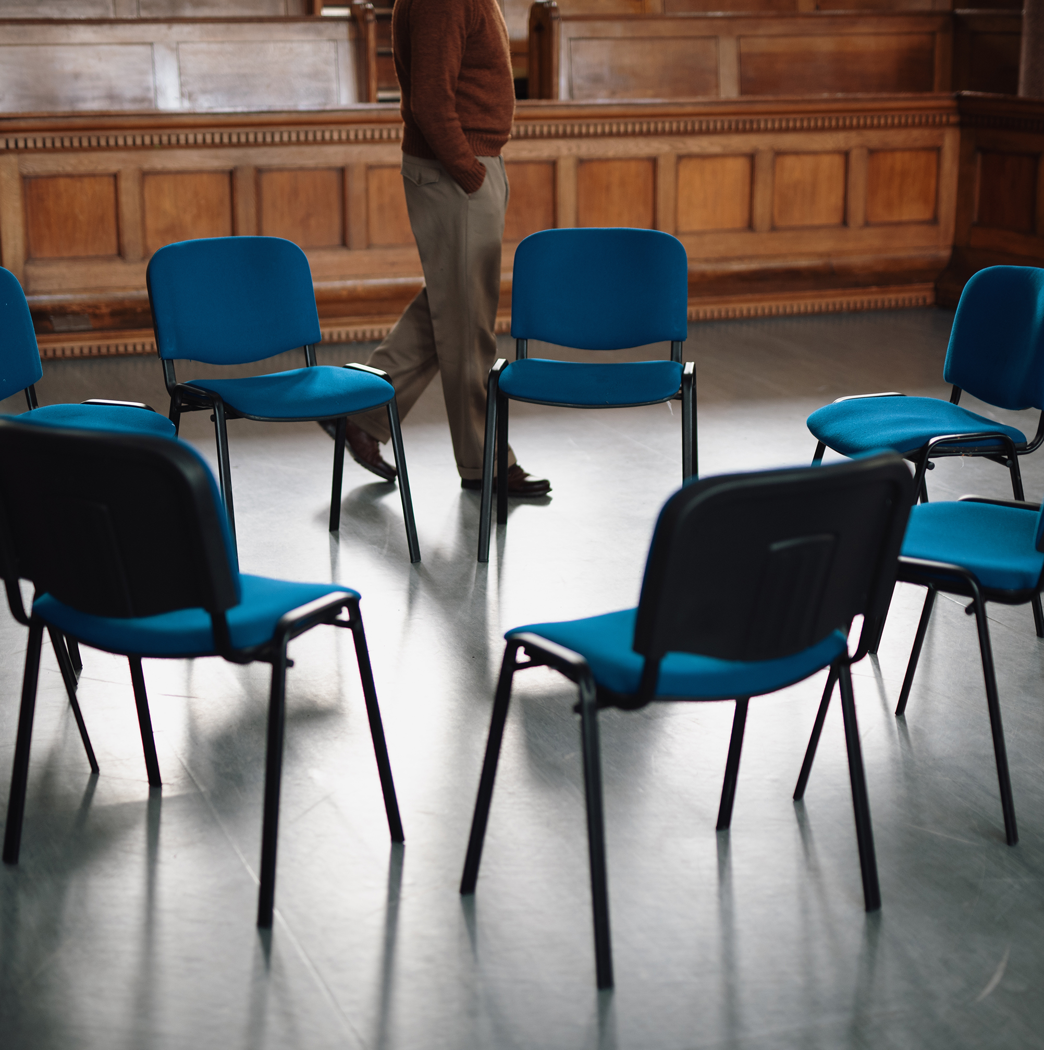
Team Dynamics?!
In-House and Contractor
Committee Negotiations

Slide 4
Communication
Email
Teams
SharePoint

Slide 5

Managing Conflict

Slide 6

Lessons Learned

Slide 7

Future Outlook

Slide 8
Thank you
Lindsay LaBella
585-435-5325
lklabella@genesee.edu

