Slide 1
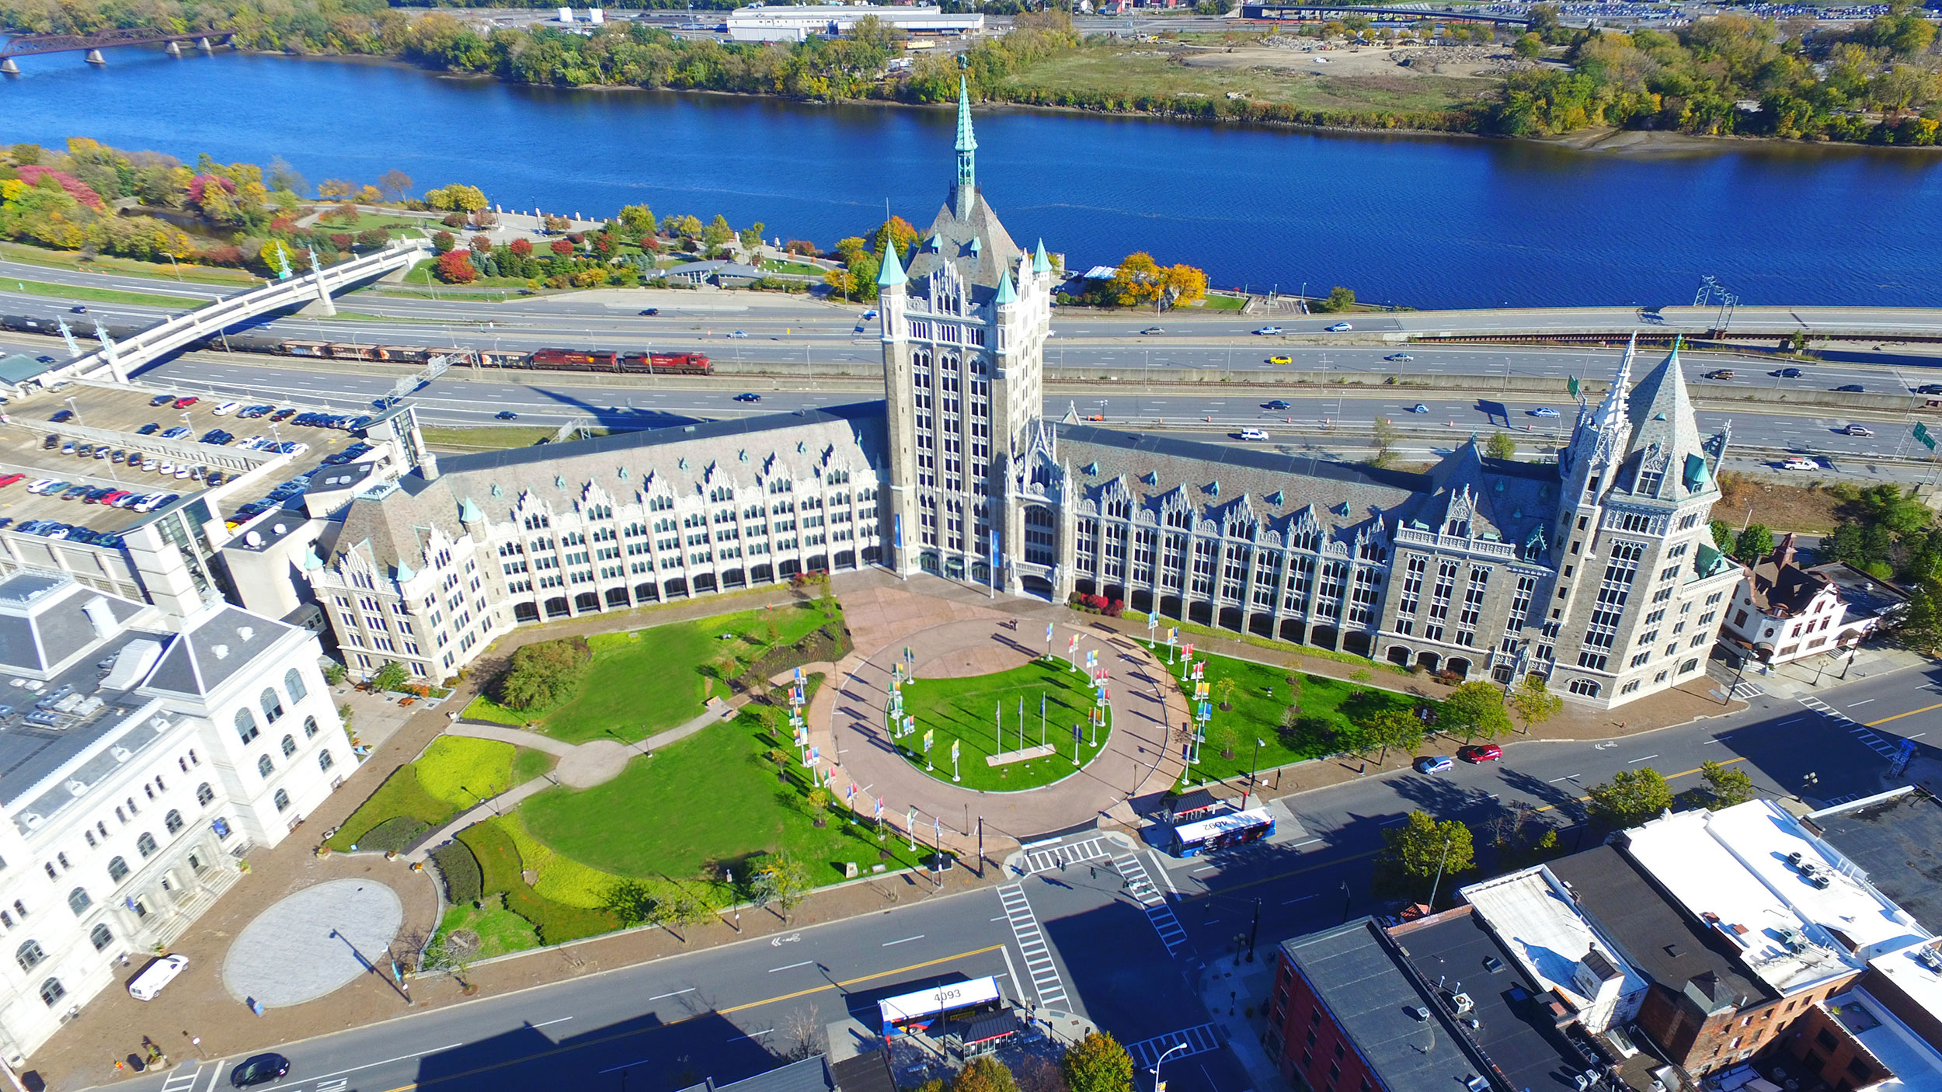
Phone Conversion Project

Slide 2
3 Years In the Making
Goals
Access Flexibility
Unified Platform
Cost Savings
U-Wide Availability
1
2
3
4
Notes:
Pandemic brought to light a need for a better way to handle phone communication. Consortium of multiple campuses started researching in 2020 for the solution Main Goals of the Project
Provide Mobility of Access. Not locked to Desk Phone.
Unified Communications Platform – One place for chat, calls, groups, meetings
Cost Savings – Lower SUNY costs when compared to current PBX offerings
U-Wide Availability – Easy ability for campuses to join in. Centralized license management/invoicing.

Slide 3
System Administration Implementation
Details
First Campus To Go
500 Lines, Jan-Apr
Communication Plan
U-Wide Tenant Host…
1
2
3
4
Notes:
System Administration
First Campus to Undergo the process of the U-Wide selected platform
Multiple waves – 500 in the first wave expected to take 3 months
Communication Plan – Ongoing but sketched out in the beginning major points of when to communicate details. Initial FAQ, then follow up items as date approaches.
U-Wide Tenant Host… Wait….

Slide 4
Wait… That was unexpected

Slide 5
Dealing with Project Problems

Slide 6
No plan of operations extends with certainty beyond the first encounter with the enemy’s main strength. – Helmuth von Moltke
“
Notes:
AKA plan for everything you can but expect problems
Commonly heard as “No plan survives the first contact with the enemy”

Slide 7
Don’t Sweat the Small Stuff
Notes:
Small issues will occur

Slide 8
Dealing with Small Problems
Expect the Unexpected
Schedule Added Time
Communication is Key
Whack the Moles
Don’t Panic
1
2
3
4
Notes:
Small issues are inevitable. Plan ahead for these as much as possible.
Add a reasonable amount of time to the expected length of the project at the start.
When issues come up, keep all the key people in the loop with concise updates, stakeholders don’t need minute details but need to know how the issue affects the project status
Take care of any issues as they arise, determine what can be done to head off similar issues
Freaking out will make everything worse. Take a step back, gather the info related to the problem, work through it.

Slide 9
Our Minor Project Problems
To Be Expected
Participant Responses
Procurement is Fun
Always the Firewall
Gripes and Glitches
1
2
3
4
Notes:
Participant Reponses – Headsets query. About half hit the deadline Also sister organization was 2 weeks late on ported number list.
Procurement – Getting the headsets. Never as quick as it seems.
Firewall – Extra time to hammer out the bumps
Gripes and Glitches – Talk it out with people. Provide as much info as possible. It’s usually not the change itself but the unknown of what will occur.

Slide 10
Rock… Meet the Hard Place
Notes:
Something comes along that no one thought of…

Slide 11
Making Hard Decisions
Options?
Cancel/Restart Project
Change Timeframes
Change Project Scope
Manage Expectations
1
2
3
4
Notes:
What are the options when project altering issues arise
Is Canceling/Restarting even possible. What is the financial hit
Can you reasonably change the time to complete the project?
Can other aspects of the project be altered/can you change the overall scope to not be as ambitious/encompassing.
Can you get key stakeholders on board with the decisions being made. Communicating to them what will need to occur based on the different options.

Slide 12
Major Unforeseen Issue
U-Wide Tenant Host
No Prior Knowledge
Extensive Setup
Dates Locked-In
1
2
3
Notes:
After we had set our port dates, discovered that there needed to be a new server environment that will play host to the U-Wide licensing. 1. Didn’t know where it could/should go
2. Lots of technical setup, testing. Networking, server admin.
3. Porting dates already confirmed by the carrier.
Usually a two month setup.

Slide 13
The Path Forward
Decisions Made
Change Timeframes
Manage Expectations
Realigning Priorities
1
2
3
Notes:
What we did
- We canceled the original port. This extended the project date a month (30 day minimum port request)
- Still cutting it close. Between us and the vendor sandwich a two month setup down to one.
- Informed stakeholders of what is going on. Planned training will start later than expected.
- Other projects/items have to wait (why I’m doing this remotely right now)

Slide 14
Do what you can, with what you have, where you are. – Theodor Roosevelt
“
Notes:
Keep at it.

