Slide 1


CIO Leadership Academy Applied Learning Project
Notes:
INTRODUCTION- Background

Slide 2


Applied Learning Project
Improved WiFi Reporting
Brian Sullivan
University At Albany

Slide 3


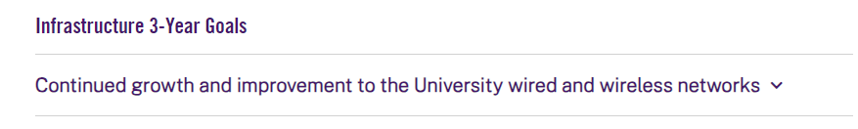
Why?
UAlbany has emphasized on the importance of an expansive and reliable wired and wireless infrastructure
Notes:
/ Succinctly state: What are you trying to do? Why? And what are the expected outcomes?

Slide 4
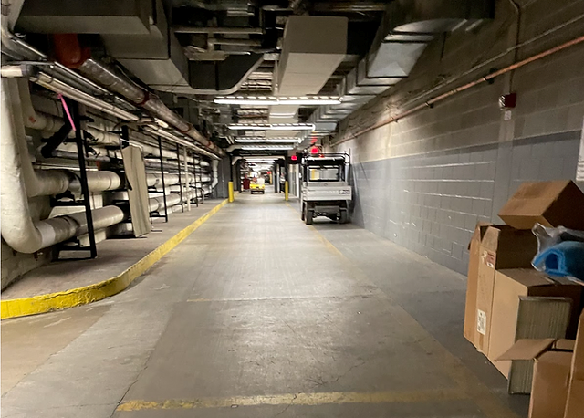

Why?
Enrollment / Retention
Increase Productivity
Health and Safety
Notes:
Cellular and WiFi coverage has been identified as a leading reason students choose a college or why students chose to leave a college
Expanded wifi allows for mobile working, or working in areas that may be more beneficial for you to be in (lab / outdoor park over traditional library)
Safety – wifi is used when cell reception isn’t available. May need to call 911
Poor cell phone reception in newer construction and Tunnels
Story of person who died in tunnel
UPD officer who was injured in tunnel and radio didn’t work

Slide 5

Project Team
The Project Team consisted of:
  ^{Network Engineers}
  ^{Field Support Staff}
  ^{Help Desk Manager}
  ^{Communications Director}

Slide 6
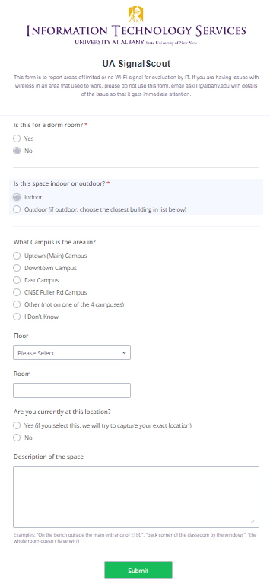
Solution – UA SignalScout
Form to report areas easily
Mobile friendly
Minimal effort to fill out
Capture GPS coordinates
Fully integrated with ticketing system
Notes:
Quick and easy
Can capture exact location
Integrates with existing service management solutions already in place.
Not re-inventing the wheel, just making it easier to use

Slide 7
Biggest Obstacles
        Awareness
          Availability
          Process
        Has to be quick, easy, and mobile-friendly
Notes:
Do people even know they can request new wifi?
How do we make them aware they can and how they can?

Slide 8
Communication Plan
        Integrate to existing documentation
        Email groups
        Integration to Rave Guardian
        Outreach events (move-in days, table in campus center, etc.)
        Posters/fliers

Slide 9


Final Thoughts
Hardest parts are still to come – Communication and improvements
Meet University goals, and improve quality of life

Slide 10

Questions?

